Slide 1


How to get clean web data for chatbots and LLMs
by František Nesveda
Notes:
Hey everyone!

Slide 2

Have you tried chatting with a website?
Notes:
Have you ever tried chatting with a website? Now, that's a stupid question, I know, so let me explain what I mean.

Slide 3
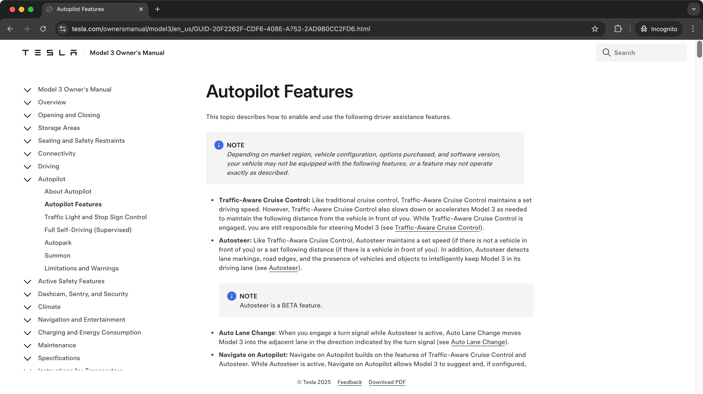
Notes:
Imagine you have a Tesla Model 3, and you want to know how to turn on the Autopilot. So you open the Autopilot documentation, you start looking, and you see how long the page is and how tiny the scrollbar is… And you start thinking "this is silly, there must be a better way!" Now, it's 2025, and you know you can just ask AI to tell you the answer. And since you're a programmer, you decide to do it the proper way…

Slide 4
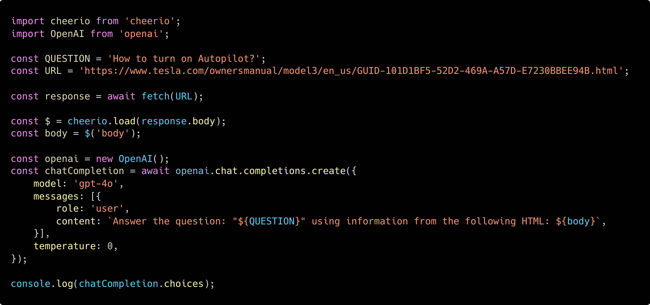
Notes:
and write a script to do it. So you have your question - "how to turn on Autopilot" - and the URL of the page where the answer is hidden. And it's simple, right? You fetch the URL, you parse the response, you extract the body of the page, you write a straightforward prompt and send it to GPT 4o, and…

Slide 5

Notes:
You get nothing. So you think "hm, this isn't working, let's try something else…"

Slide 6
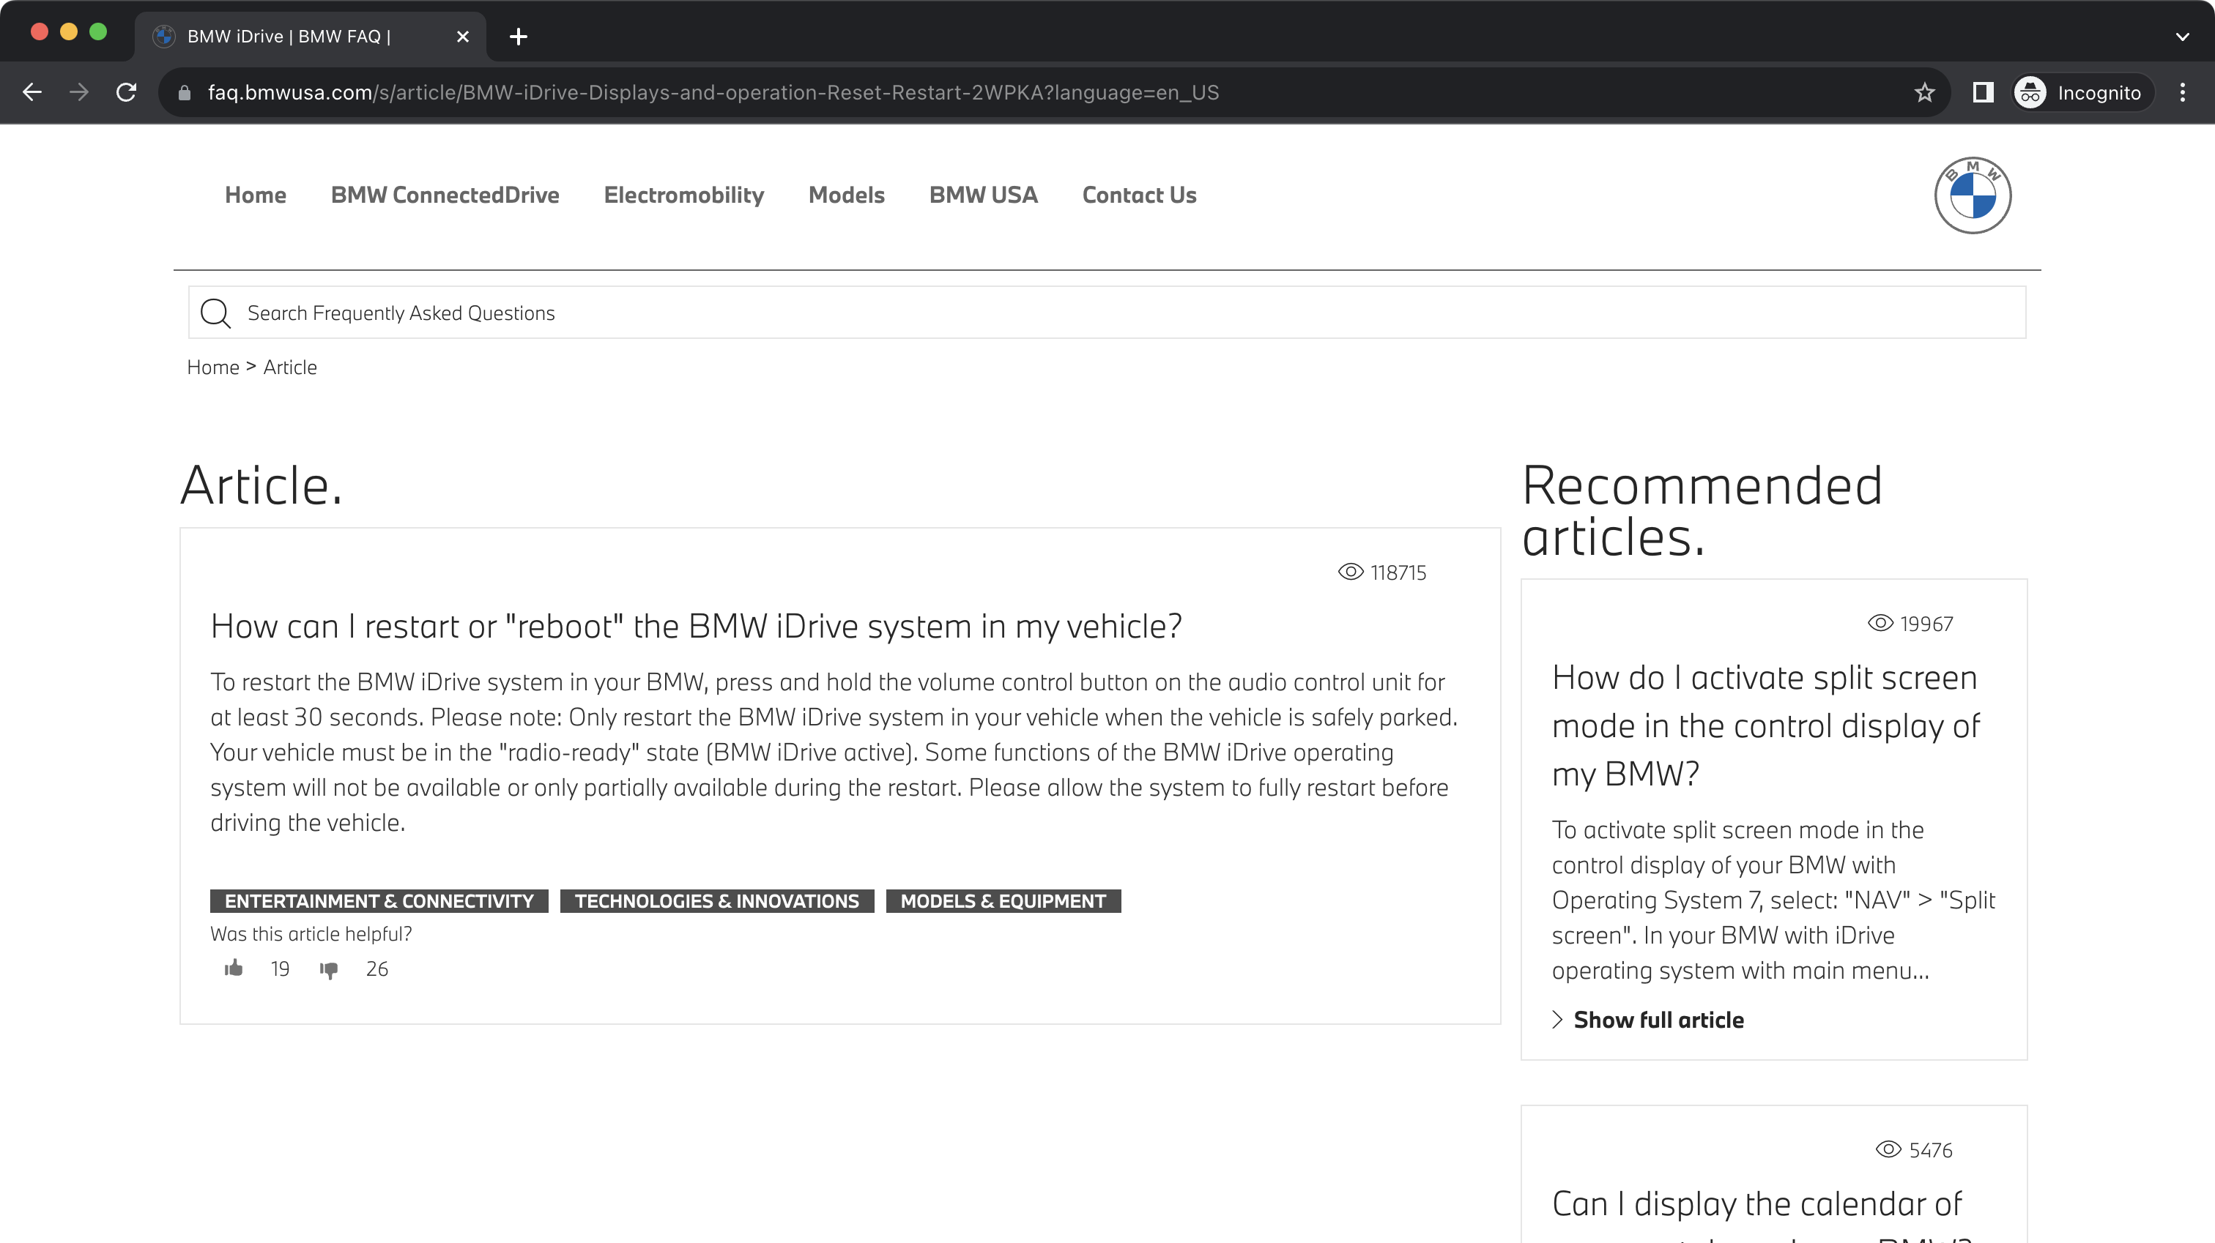
Notes:
And you buy a BMW. Now, the BMW has some issues, and you have to restart the built-in infotainment.

Slide 7
Notes:
You adjust your script to load the BMW website, and ask it a simple question - "How to restart iDrive"?

Slide 8
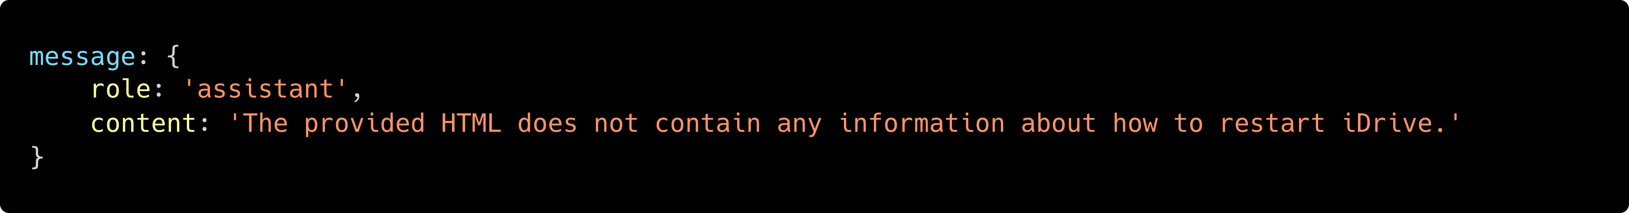
Notes:
And you still don't get anything useful.

Slide 9
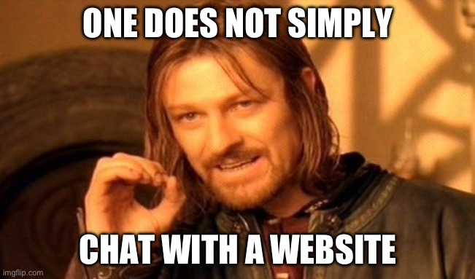
Notes:
Eventually you find out that the Tesla website blocked you from downloading it, and the BMW website is rendered dynamically in the browser, so the HTML you fetched really does not contain the needed information.

Slide 10

How to get clean web data for chatbots and LLMs
František Nesveda
Full-stack engineer & Team leader
Notes:
Hi, I'm Franta, I'm a full stack engineer & team leader at Apify, and today I want to tell you how to do it if you really want to chat with a website.

Slide 11
Reliably fetching page content.
Notes:
Let's take a look at the agenda for today. As we saw earlier, fetching page content is problematic, so first we'll talk about how to do it reliably, and how not to get blocked.

Slide 12
Reliably fetching page content.
Parsing HTML for LLMs.
Notes:
Next, we'll talk about how to parse the fetched pages so that we can feed only their actual content to the LLMs, not all the other junk that's on a webpage.

Slide 13
Reliably fetching page content.
Parsing HTML for LLMs.
Crawling all the pages you need.
Notes:
Once we're able to fetch the websites and parse them, we'll talk about how to do it at scale, so you don't have to fetch the website page by page, but all at once.

Slide 14
Reliably fetching page content.
Parsing HTML for LLMs.
Crawling all the pages you need.
Creating a chatbot with LangChain.
Notes:
And last, we'll put it all together and do a quick demo of creating a chatbot with LangChain.

Slide 15
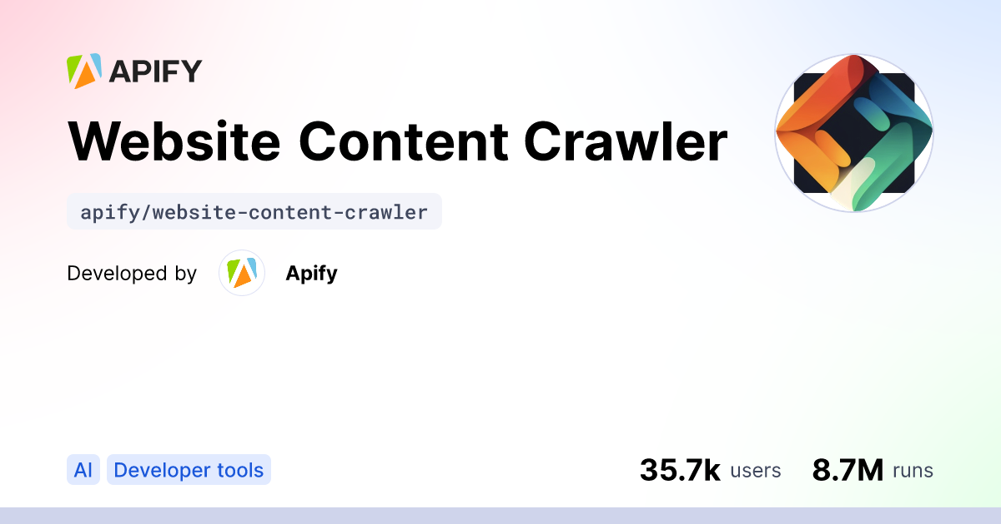
Notes:
Now, at Apify, we have a tool called Website Content Crawler, which does all the scraping and parsing for you, and the things I'll be talking about today are knowledge we learned when developing this tool.

Slide 16
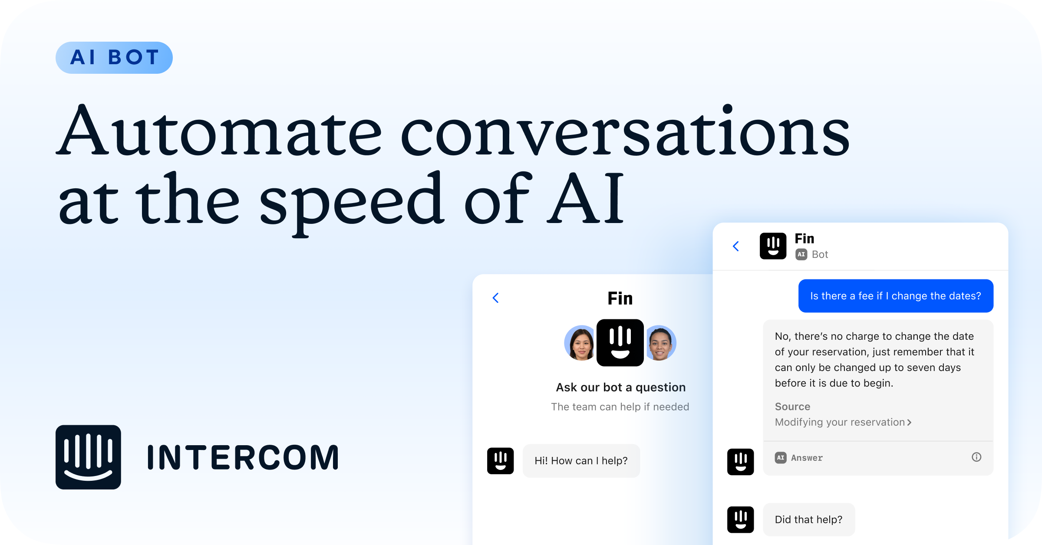
Notes:
The Website Content Crawler is not just some toy project, but an actual product used for example in Intercom's Fin. Fin is a chatbot which you can embed in your own website, and it allows your website's visitors to chat with the website. For Fin to be able to answer their questions, it actually scrapes and parses your own website, and it does that using the Website Content Crawler by Apify. ——— only if you have time ——— Now, you might think "wouldn't it be easier to just load the documentation into the chatbot via some side channel, and not deal with the scraping?" And the answer is "If you were doing it only for a single website, then yes, but if you want to have a universal, one-click solution easily applicable to tens of thousands of websites, and which correctly shows the sources for the answers it gives, just scraping the websites is easier".

Slide 17
Reliably fetching page content.
Notes:
So, let's take a look at the specifics of getting the clean web data. First, we have to reliably fetch the webpage content without getting blocked.

Slide 18
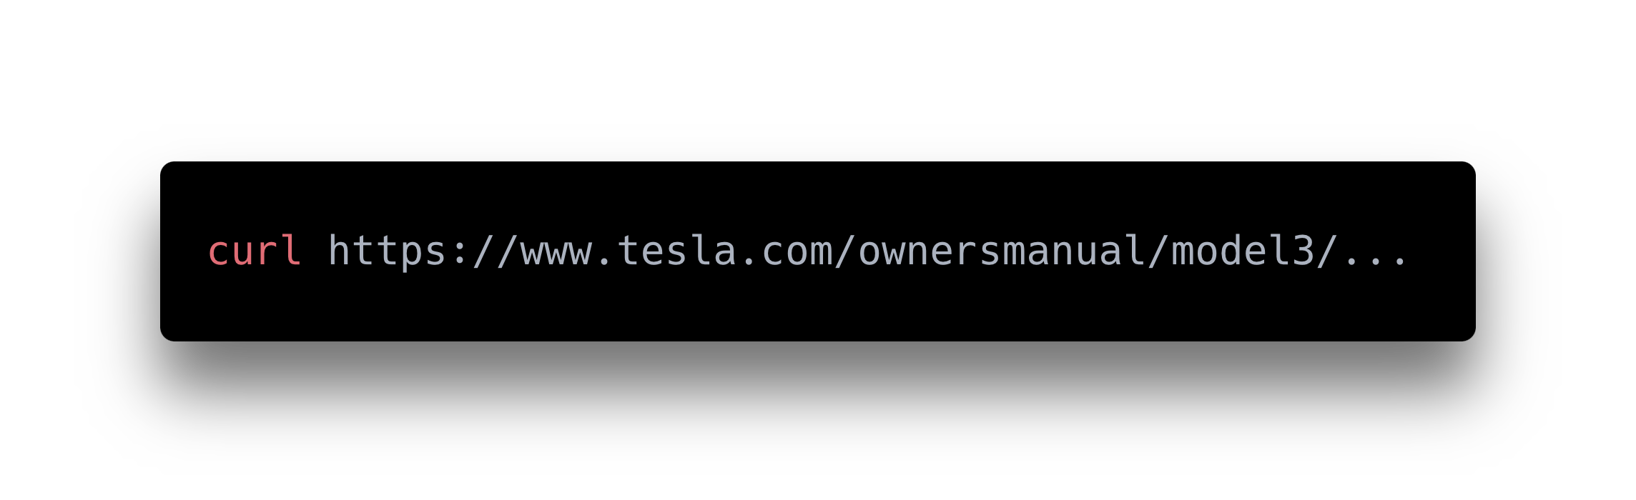
Notes:
Fetching a webpage should be simple, right? You can just use a normal HTTP client like CURL to get the content.

Slide 19
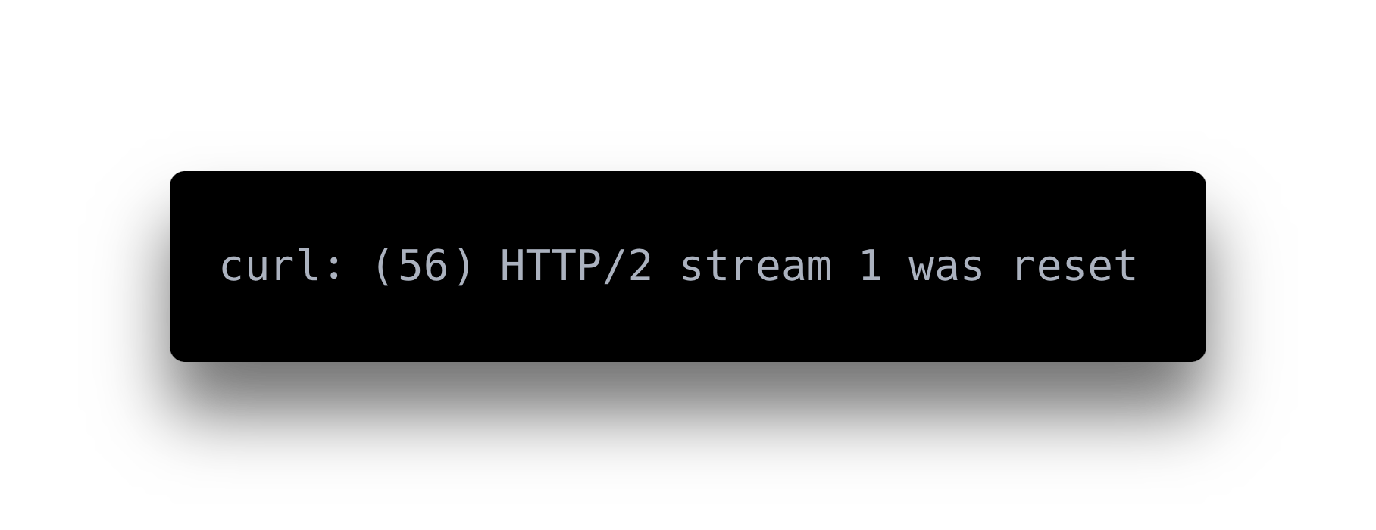
Notes:
Unfortunately, the websites will detect you're not a regular user, and they will block you.

Slide 20
We must be human-like.
Notes:
To not get blocked, you need to look like a real human to the web server.

Slide 21
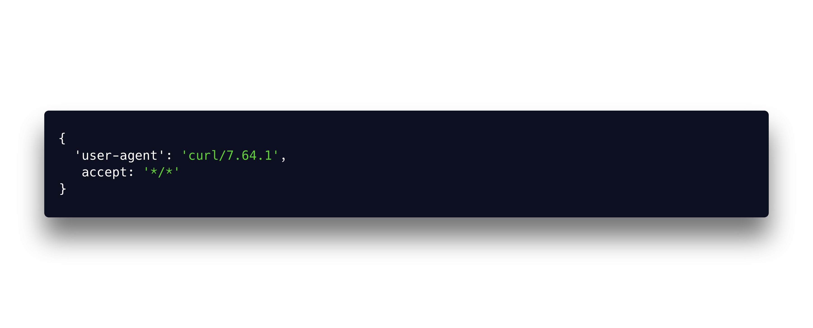
Notes:
A real person doesn't look like this…

Slide 22
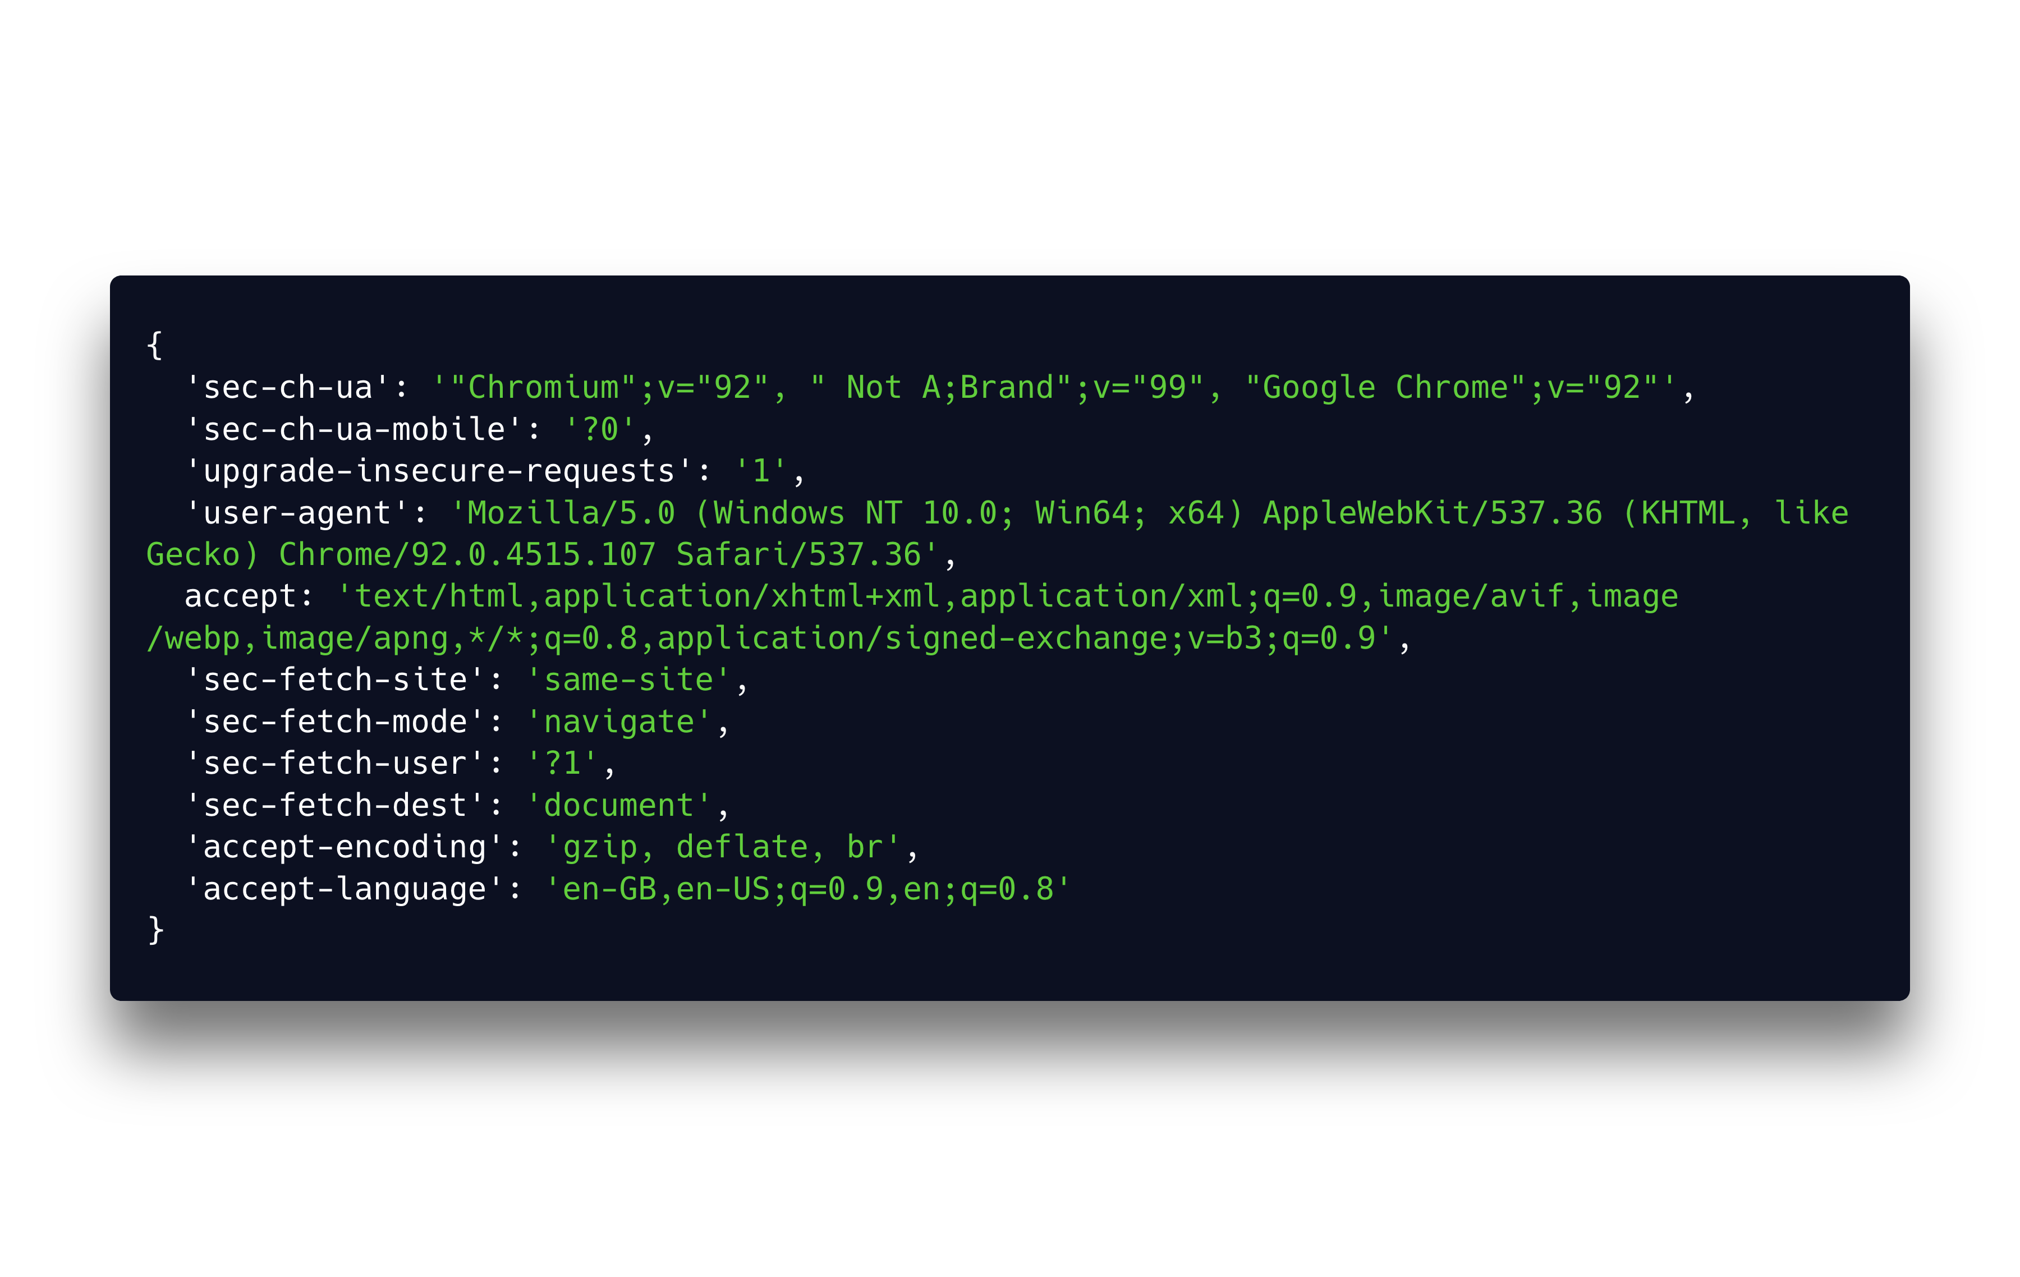
Notes:
They look like this. These are all the headers a browser is sending as part of the HTTP request to the web server. There is the browser version, whether the browser is a mobile device or not, what content types can the browser accept, what languages and compression… and so on.

Slide 23

Headers
HTTP 3
TLS versions
ECDH ﻿Curves
Ciphers
Signature
Algorithms
Notes:
And it's not just about the headers. Web servers can detect if you're a bot based on the encryption algorithm used in the request, or the HTTP version (most browsers now support HTTP 3), and many other parts of the request. Dealing with all this yourselves would make your head explode,

Slide 24
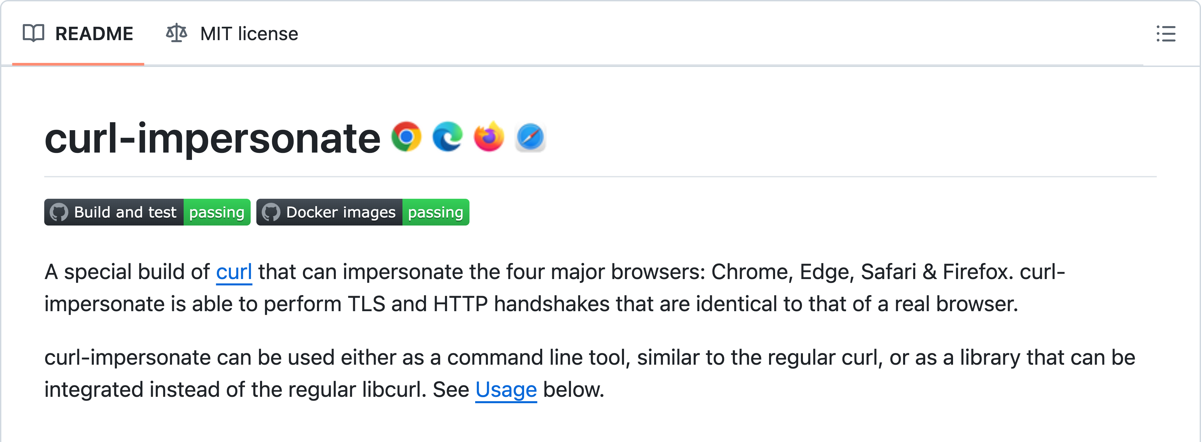
Notes:
but fortunately, there are ready-made tools and libraries which take care of it so you don't have to. One such tool is curl-impersonate, which is a special build of CURL which can behave like any of the major browsers.

Slide 25
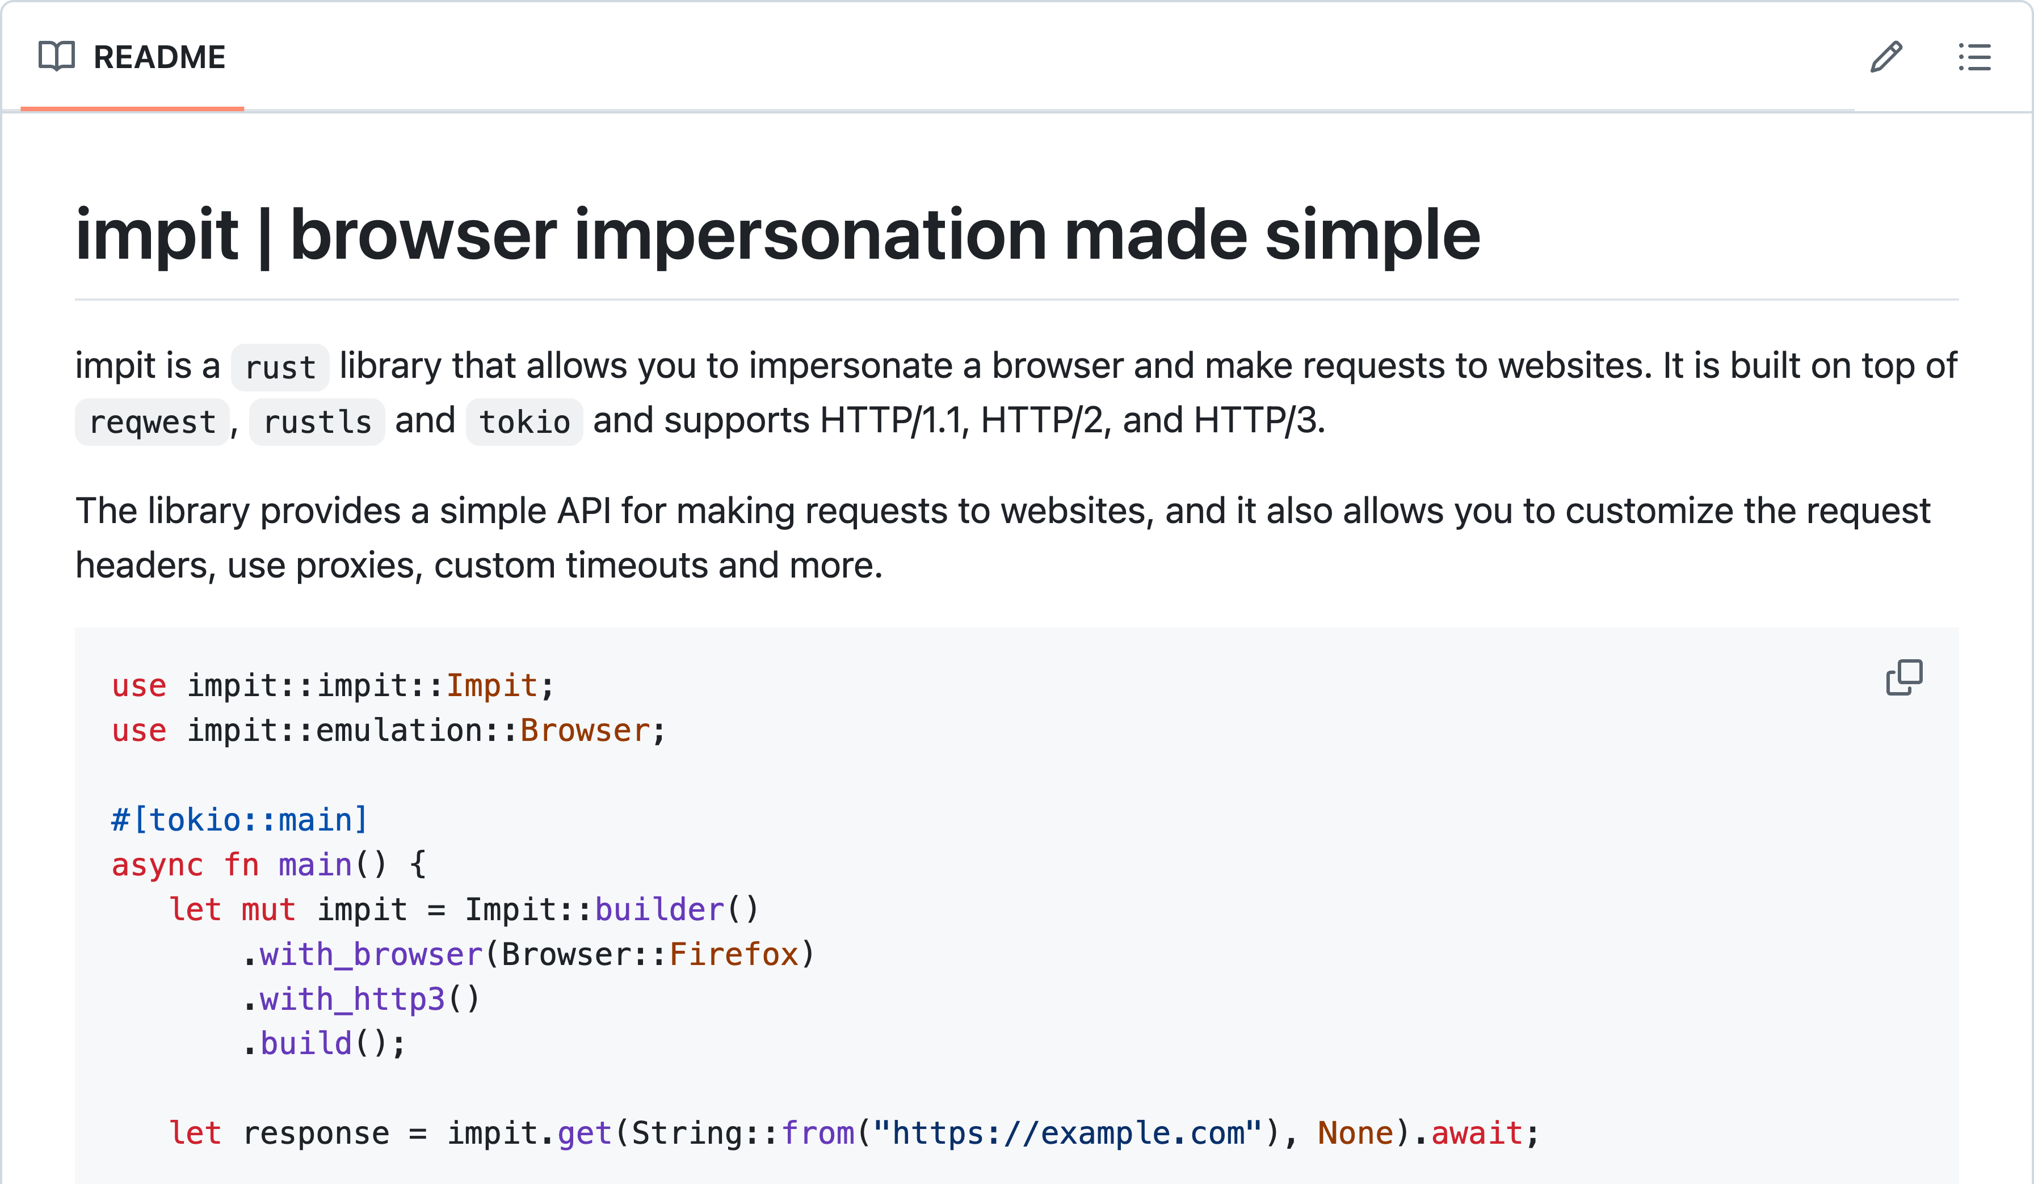
Notes:
Another tool with similar features is impit, which is a library written in Rust, but has bindings also to Node.js (TODO: Python coming soon)

Slide 26
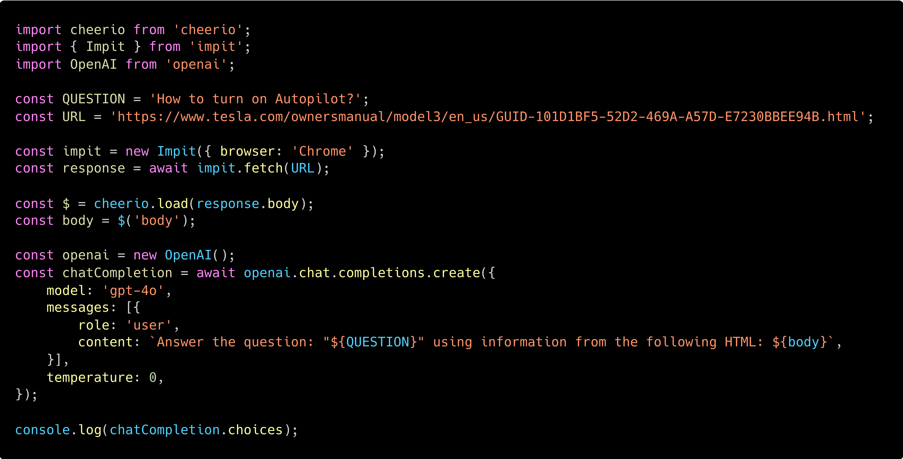
Notes:
So, let's try it. We take the same simple code as in the beginning, except we don't fetch the page normally, but through impit, and…

Slide 27
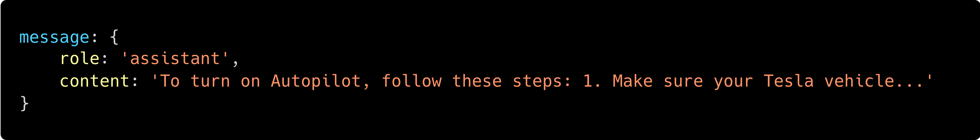
🎉
Notes:
We have our answer.

Slide 28
Are we human-like yet?
Notes:
So, is our behavior human-enough?

Slide 29
No. Browsers also execute JavaScript.
Notes:
Not yet. In our simple script, we just loaded the website's raw HTML and tried to parse it, but browsers also execute JavaScript.

Slide 30
Notes:
The BMW website is lazy-loaded, which means that the first HTML response doesn't contain the actual content, and the content is only loaded and rendered later, through client-side Javascript code.

Slide 31
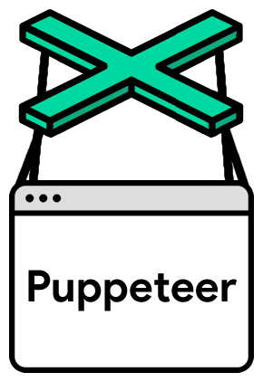


Notes:
That's why for scraping some websites, we have to use actual browsers. There are a bunch of libraries which allow you to control a browser. You've probably heard about Selenium, which used to be the most widespread browser automation library for a long time. These days, it has strong competitors in Puppeteer and Playwright. Each of these allow you to automate multiple kinds of browsers, like Chrome or Firefox, and open webpages and inspect their content.

Slide 32
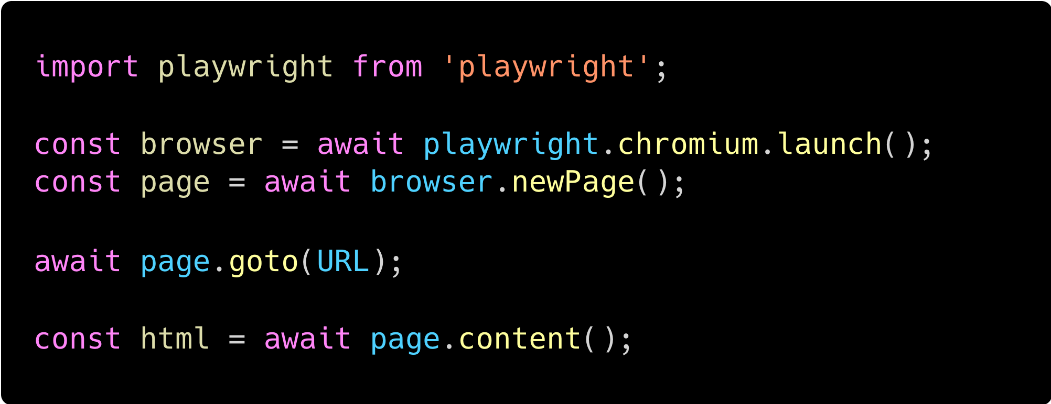
Notes:
We'll use Playwright, since it's the most modern of them all, and it's supported in both Python and Node.js. In just five lines of code, we can launch a Chromium instance, open a tab, load a website, and get its content.

Slide 33
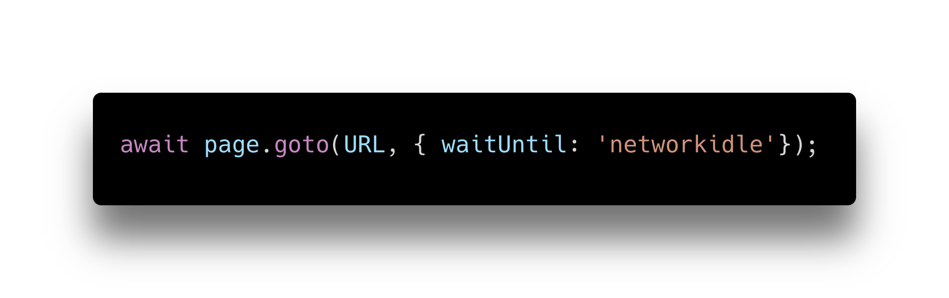
Don't forget to wait for content to load.
Notes:
Now, to actually get the content of a lazy loaded website, you have to make sure that you wait for the content to finish loading. That's why, when we're loading the webpage, we'll wait for the "networkidle" browser event, which means that all content has finished loading, and there is no network traffic anymore. This might be overkill for some pages, where the content is available earlier, but for the universal usecase, where we don't know which website we'll be scraping, this is a surefire way to know the website has finished loading.

Slide 34
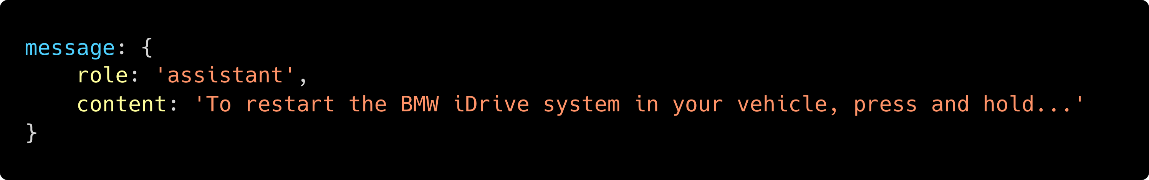
🎉
Notes:
And voila! Now even the BMW website responds to our questions.

Slide 35
Prepare to fight anti-bot software.
Notes:
So, the Tesla and BMW website examples worked, which is great, but that's not enough for the universal usecase. There are a lot of clever, creative bot detection softwares that we have to fight.

Slide 36
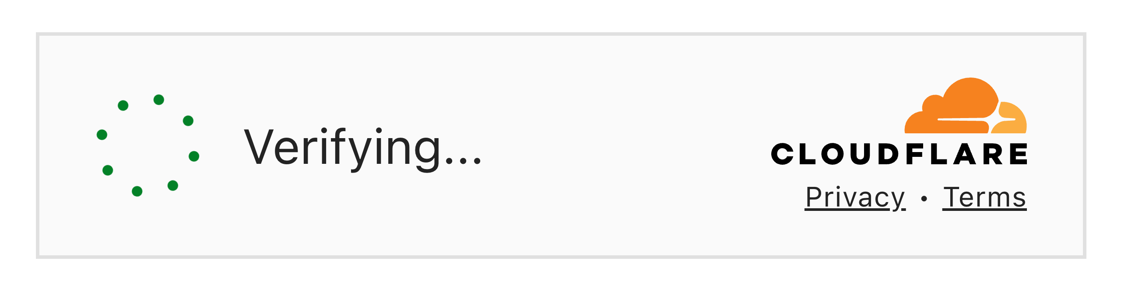
Notes:
You probably know CloudFlare, which has one of the best bot protections on the market, and it's used on a lot of websites.

Slide 37
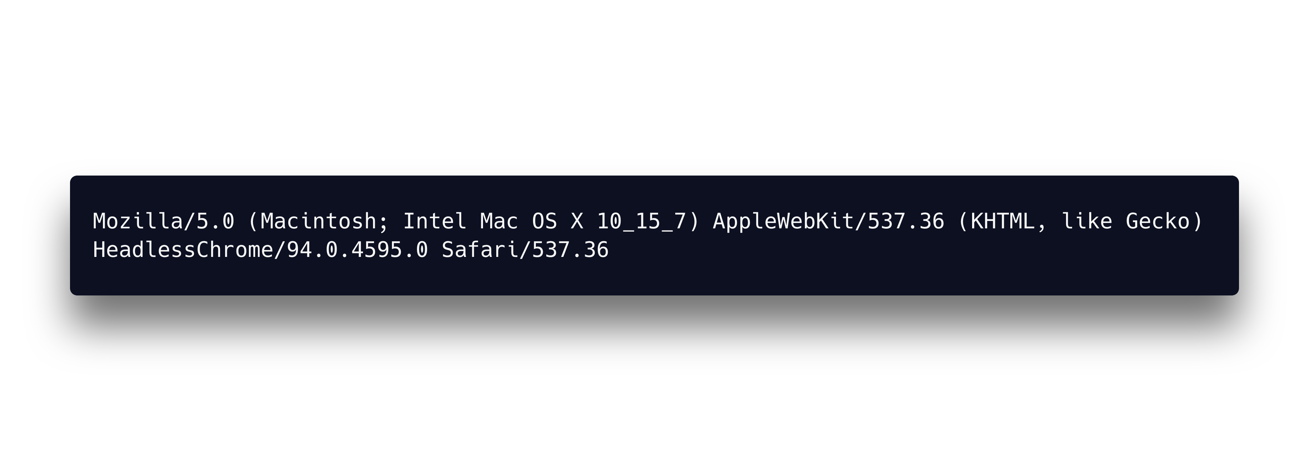


Notes:
If the website was using Cloudflare protection, it would block even our script with the browser automation through PlayWright. That's because by default, the headless browsers actually identify as headless browsers in their user agents.

Slide 38
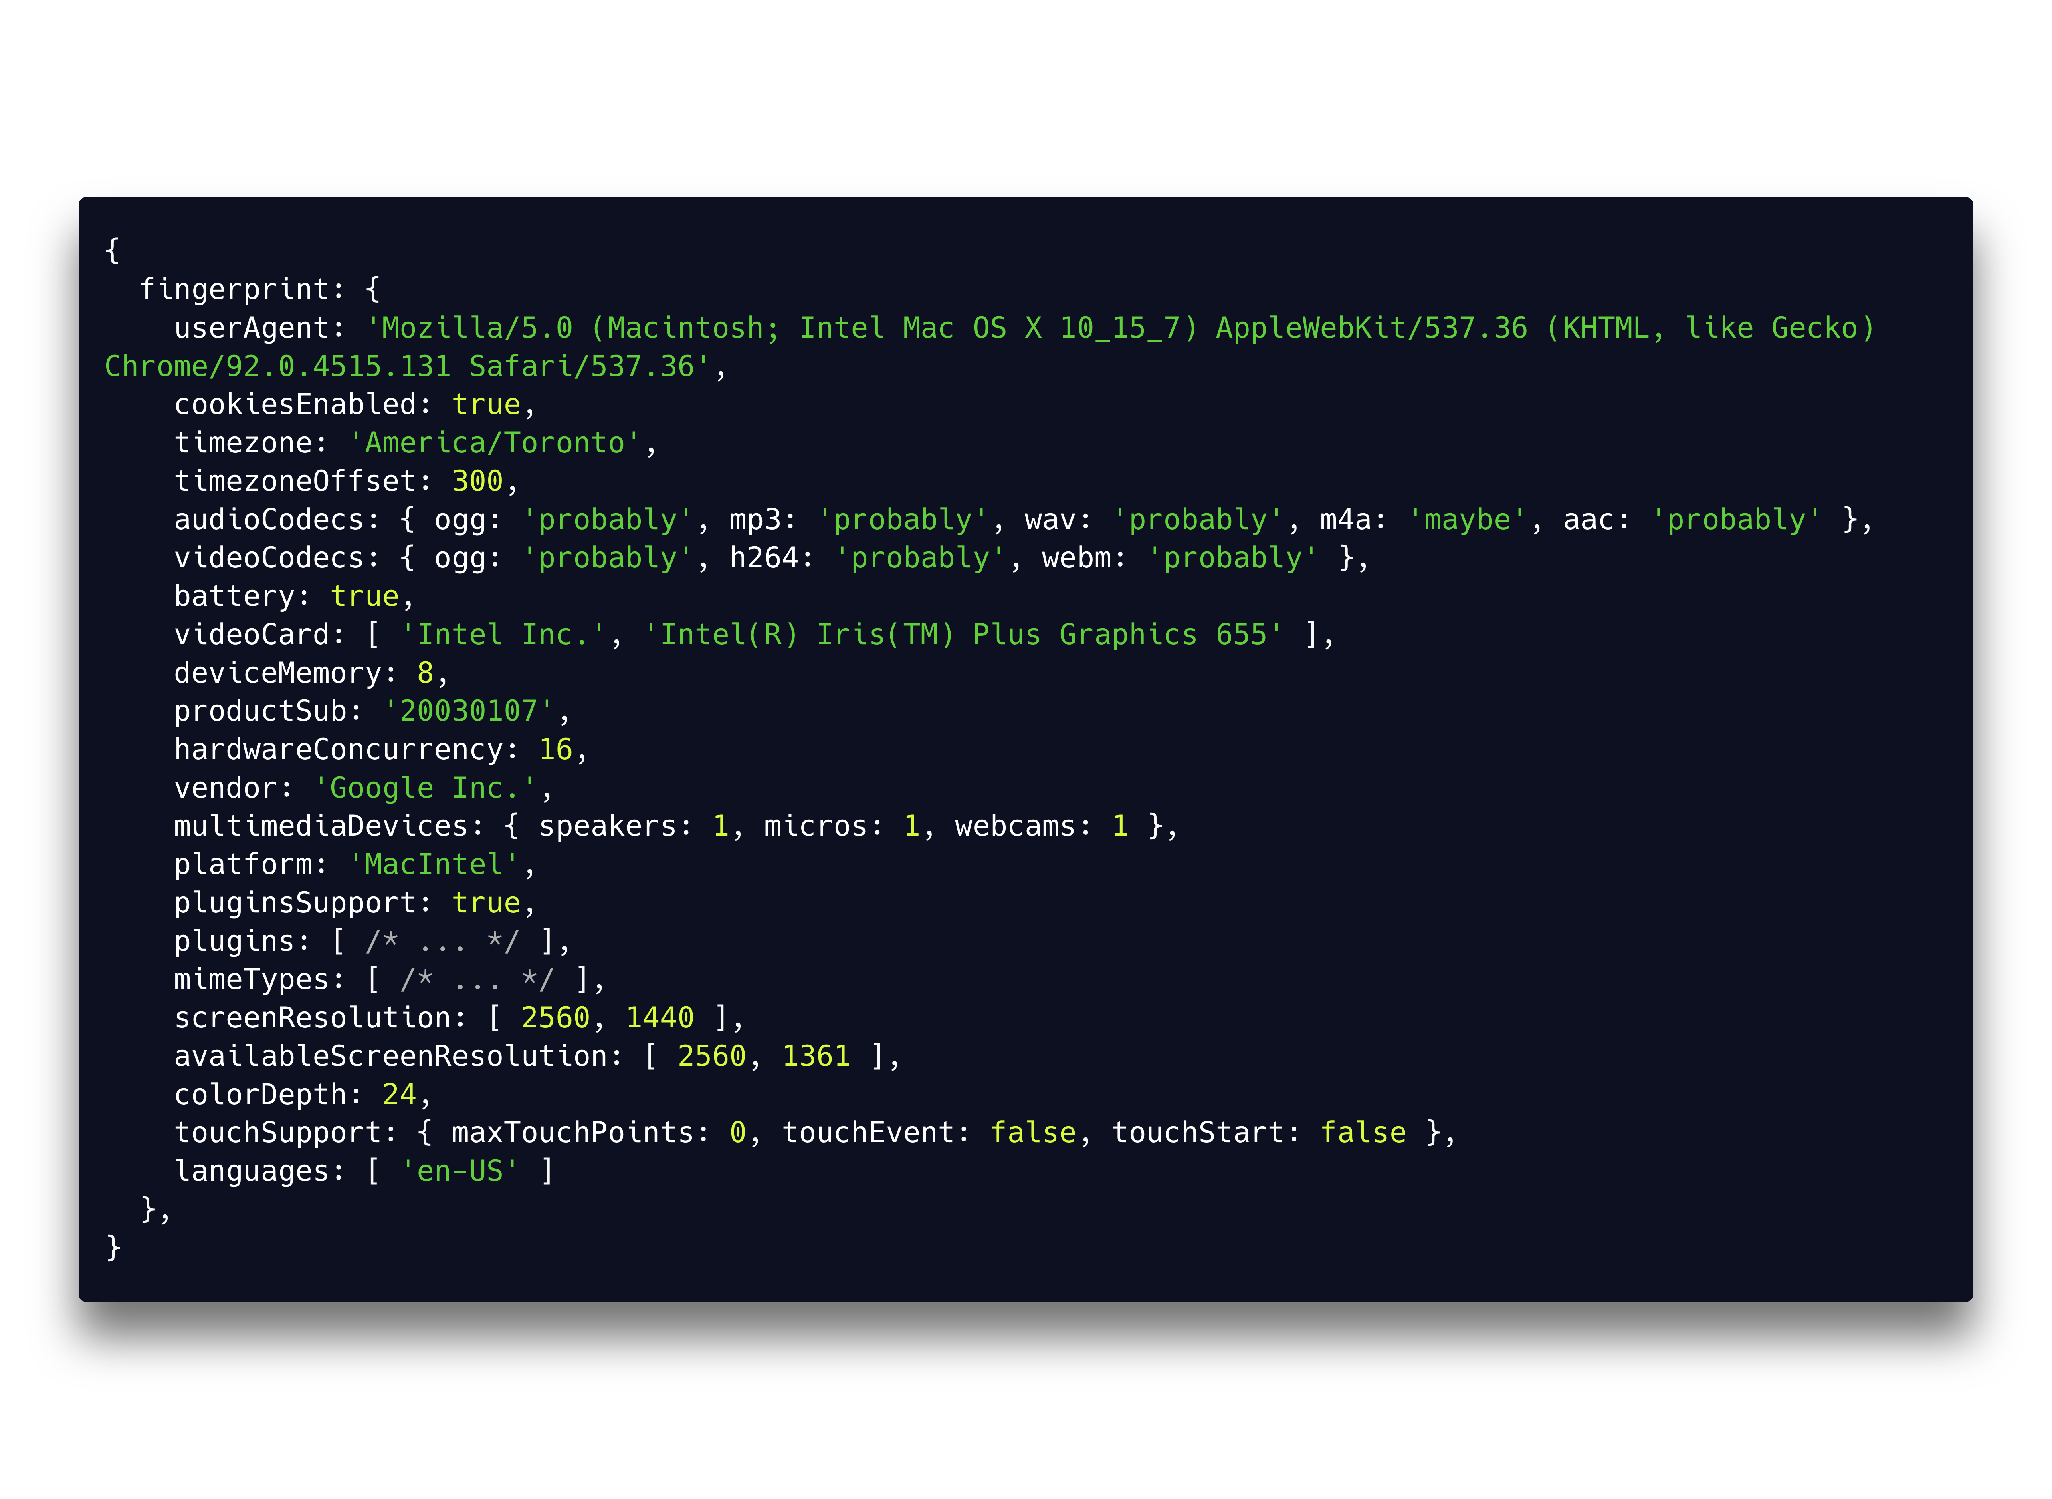
Notes:
The anti-bot software uses the user agent, the headers you send with the requests, details about your browser and your hardware, and a lot of other information, to create what's called a "fingerprint" of your device. And based on that fingerprint, they decide whether you're a real person, or a bot. So, to appear as a real person, you have to have a real fingerprint. It's not enough that all the properties of your fingerprint are real, they also have to make sense in combination with each other. So for example you can't have a 2024 MacBook Pro with just 8 GB of memory, because that's not a real device.

Slide 39
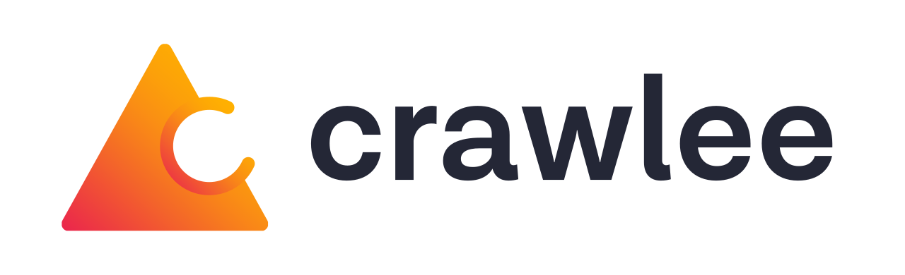
puppeteer-extra-plugin-stealth
selenium-stealth
Notes:
Fortunately, there are a lot of libraries that help you deal with that, and have a real fingerprint. There are "stealth" plugins for Puppeteer, Playwright or Selenium, or you can use a full-blown scraping library like Crawlee, which is available for both Node.js and Python, and which helps you manage the scraping and impersonation all at once.

Slide 40
What about web scraping APIs?
Easy to start with, but costly at scale.
Notes:
Now, at this point, you might think, "I don't want to deal with all this, I just want to quickly scrape a webpage". There are a bunch of web scraping APIs that allow you to send a URL of a page and get its content, with the API taking care of the blocking and impersonation. And they're great, if you need to quickly start scraping just a few pages, but if you want to scrape at scale, they soon start costing you a loooot of money, because you're paying for every single page.

Slide 41
Parsing HTML for LLMs.
Notes:
So, now we know how to reliably get the HTML content of the website. The next step is parsing the HTML so that you can feed it into an LLM.

Slide 42
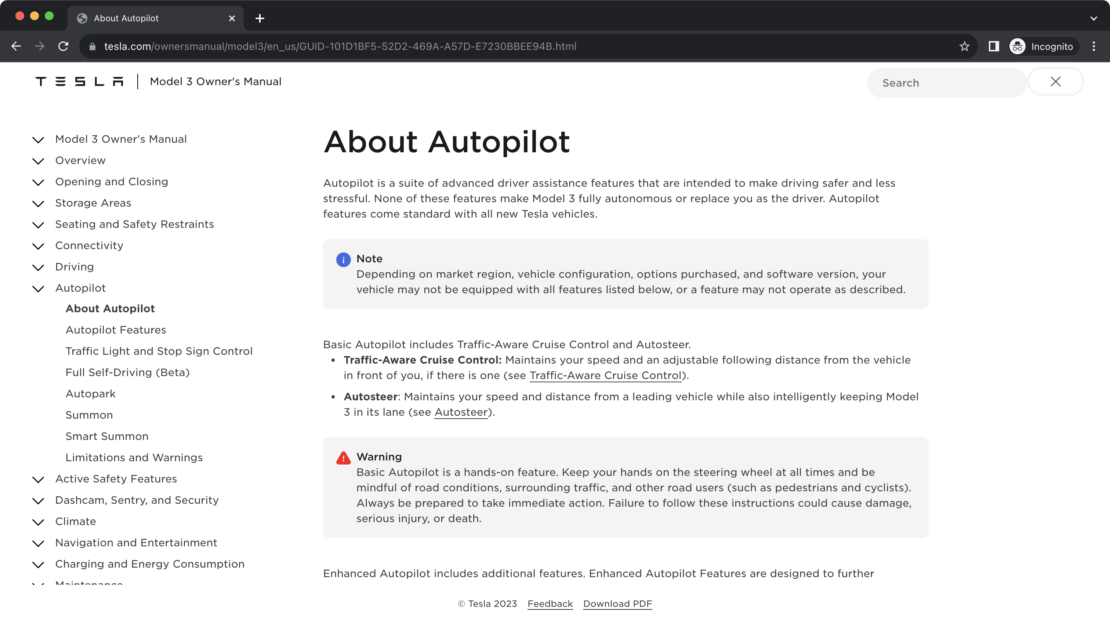
Notes:
If you look at the webpage, there's a lot more to it than just the actual content. There are headers, menus, navigations, search bars, footers, and so on.

Slide 43
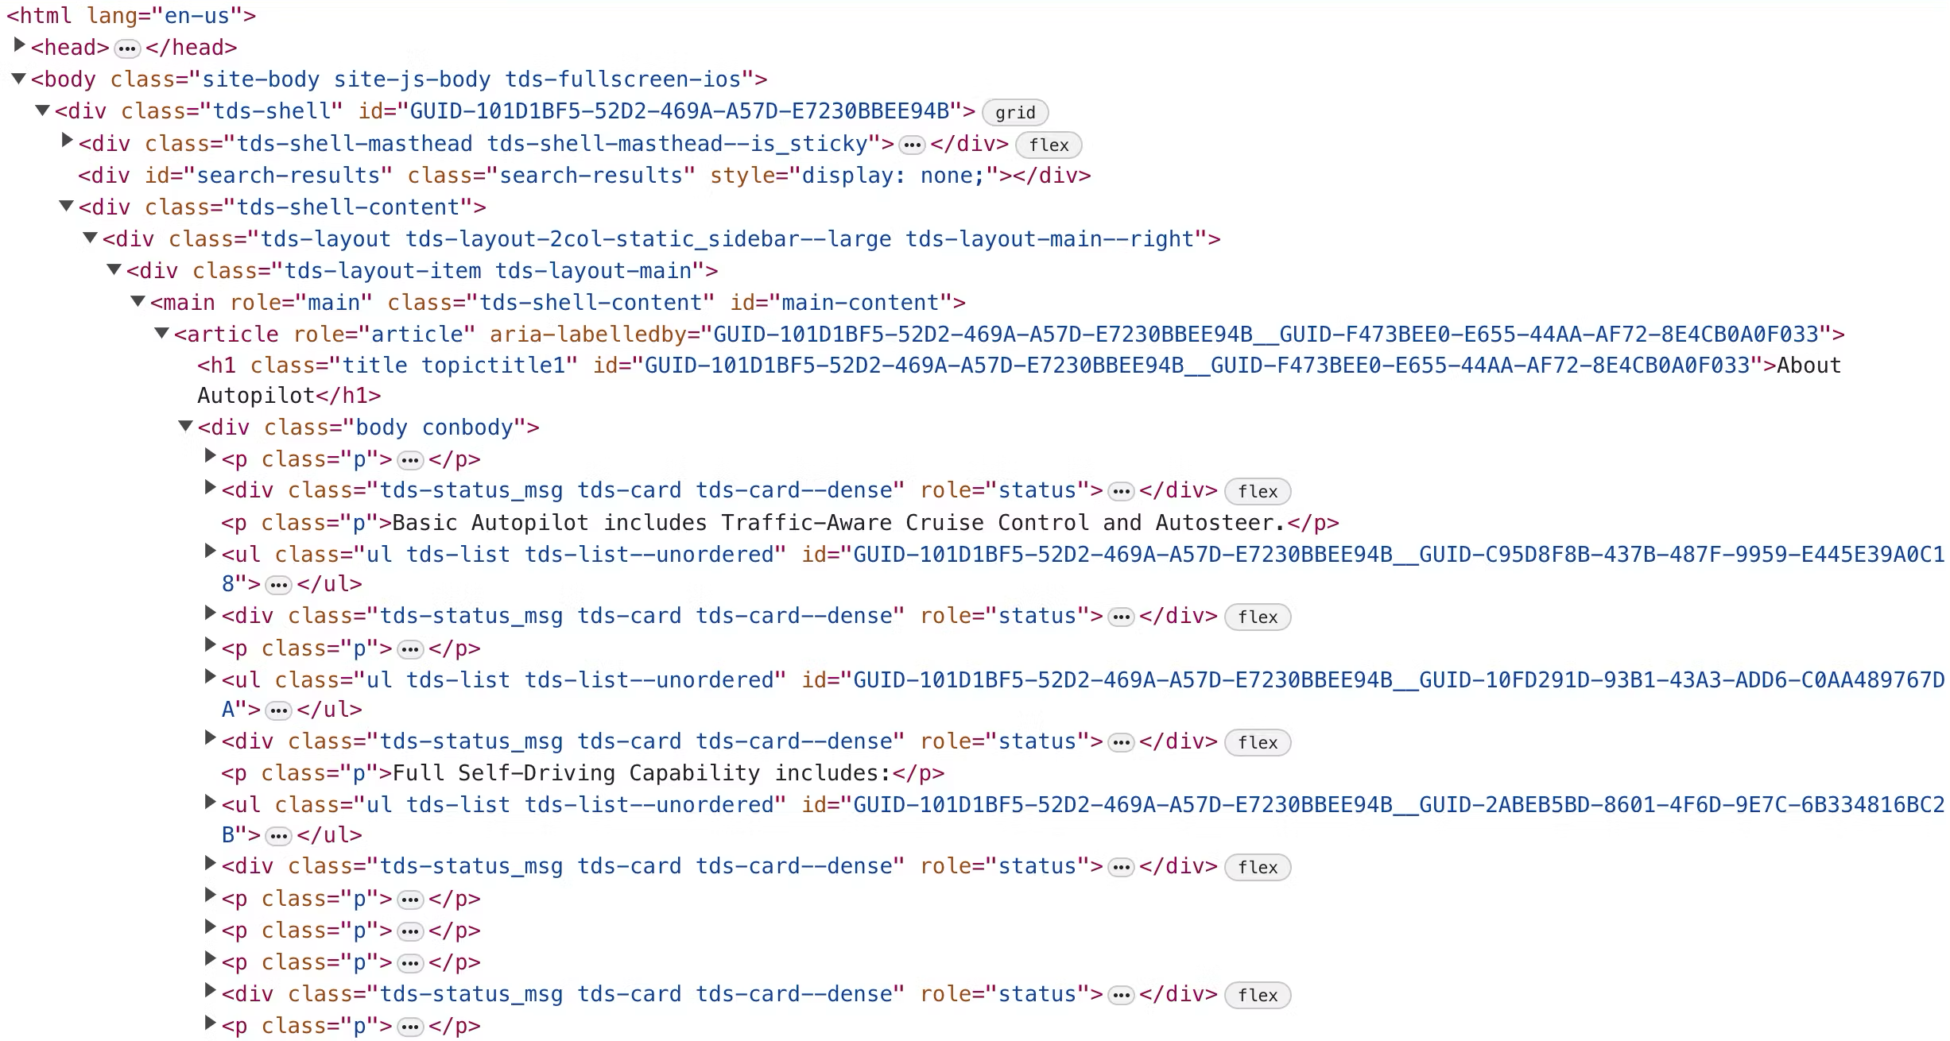
Notes:
If you look at the HTML of the page, you can see that it's pretty complex, with a lot of extra elements, scripts, styles, long attributes and whatnot. You don't want to feed that straight into the LLM. First of all, a big HTML eats a lot of tokens, and so it's slower to process and costs more, and it might not even fit into the context window. Second, since there's a lot more content fed to the model, the actual data you need might get lost, and the model might get confused. That's why we need to extract the actual content first before feeding the page to the model.

Slide 44
Start with @mozilla/readability
Notes:
There are a lot of things you can try, but don't waste your time, and just start with Mozilla's Readability library.

Slide 45
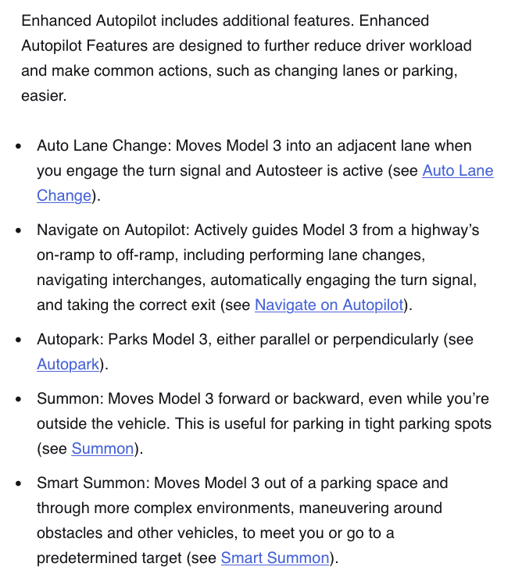
Notes:
The readability library is what's powering the Reader View in Firefox, which strips away the clutter like advertisements, buttons, images and videos, and lets you read just the content of the page in a nice, unified format.

Slide 46
Sadly, Readability isn't 100% reliable.
Notes:
Readability is a great start, but it's not bulletproof, and sometimes doesn't strip away everything, and keeps things like menus or footers.

Slide 47
Keep noise out of your embeddings.
Notes:
For a lot of usecases, you want to search through the scraped webpages, so you need to keep noise out of your embeddings.

Slide 48
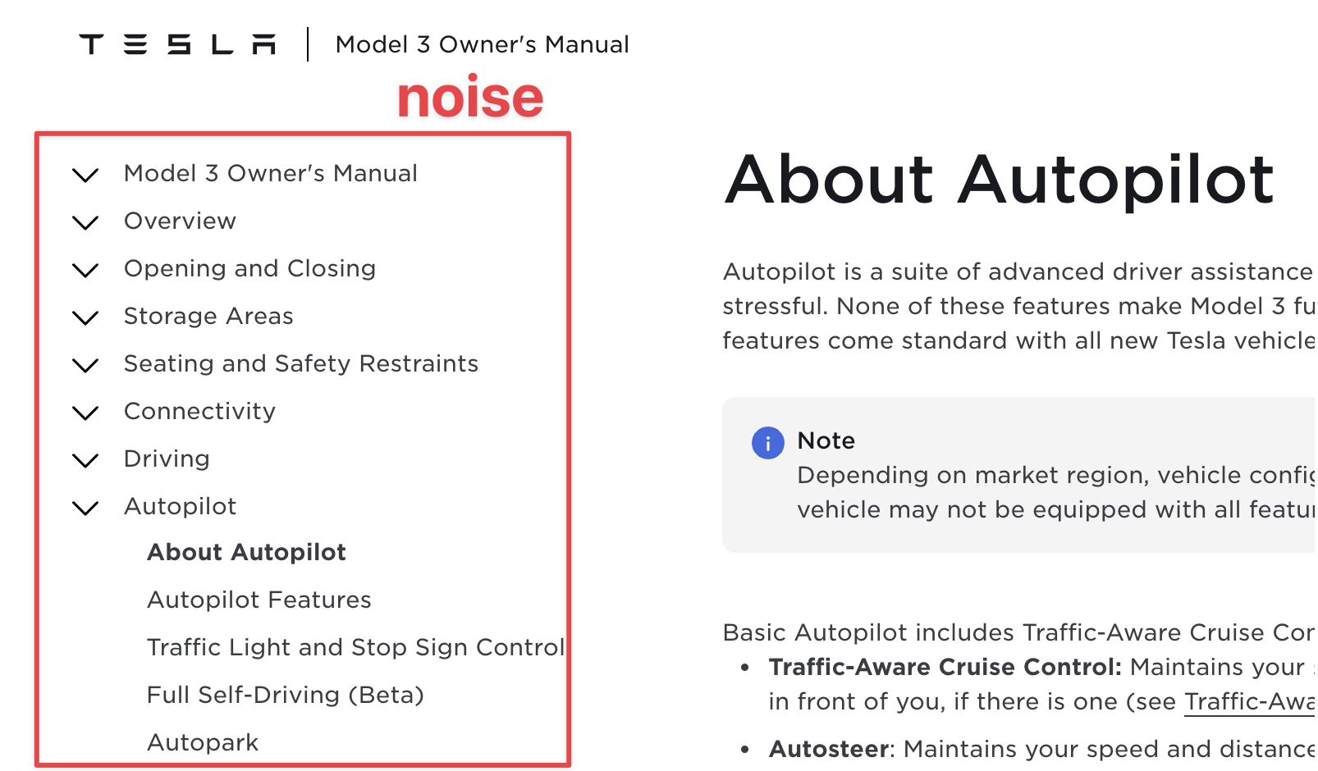
Notes:
If we look at the Tesla website, the menu on each page contains a lot of keywords which are not present in the main content, which could confuse vector search.

Slide 49
Seating
Storage
Driving
…
Autopilot is a suite of advanced …
Seating
Storage
Driving
…
When you open a door …
Seating
Storage
Driving
…
Model 3 is designed to …
Notes:
If the menu was present in the embedding of each page, vector search on the embeddings wouldn't work, because it would be hitting the keywords in the menu in every page.

Slide 50
Autopilot is a suite of advanced …
When you open a door …
Model 3 is designed to …
Remove shared lines (Count-min Sketch)
Notes:
To remove the menus, we can use an algorithm such as the Count-min sketch to detect lines which appear in a majority of the documents, and remove those shared lines, which leaves us just with the unique content in each page.

Slide 51
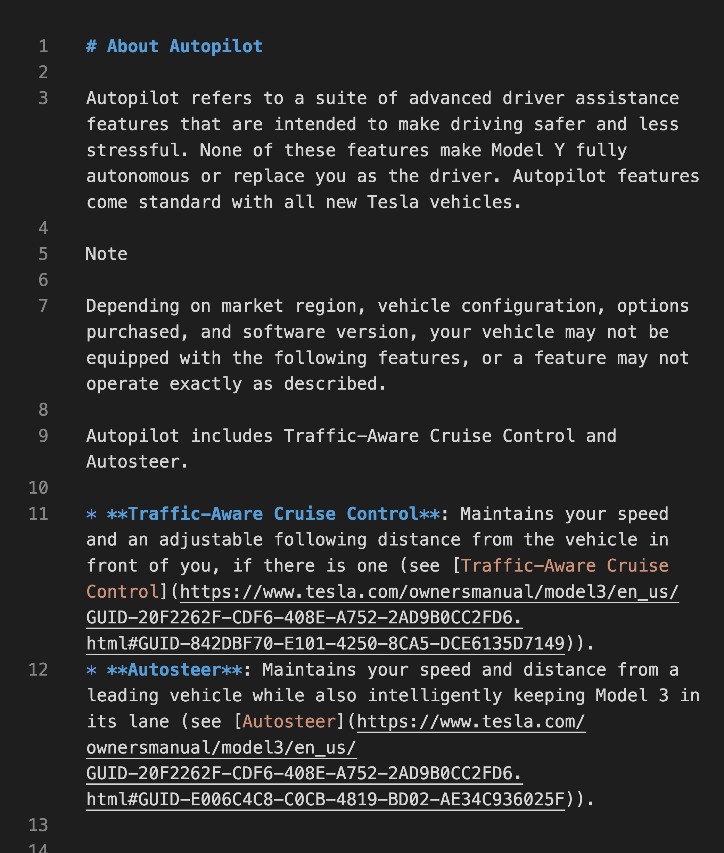
Convert to markdown
Notes:
Now, when we've removed the shared content, we can convert the HTML into markdown. Markdown is better than HTML because it's shorter and contains only the actual content, not the HTML elements. It's also better than just plain text, because it keeps the structure and contextual information of the webpage while being only marginally longer.

Slide 52
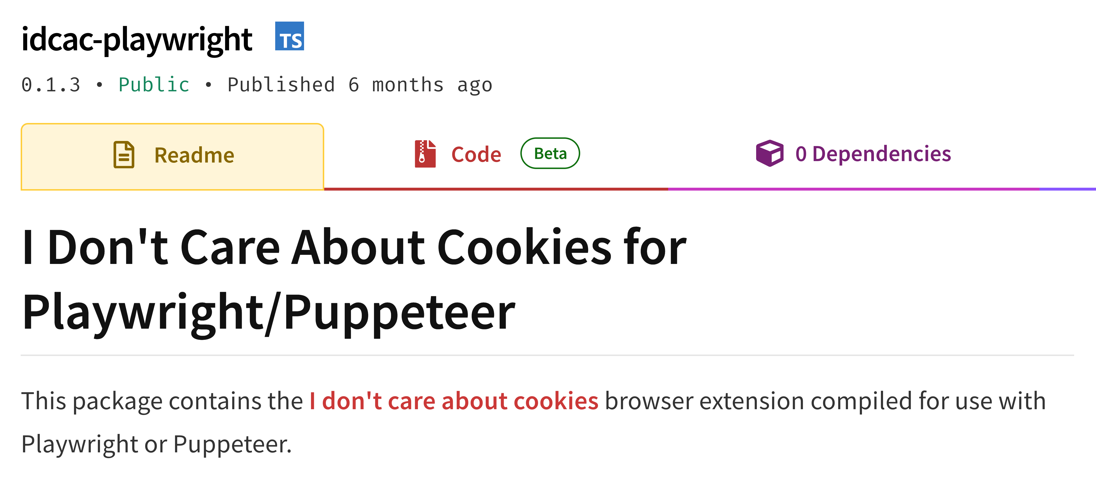
Close popups to prevent wrong extractions:
Notes:
Readability is also not 100% reliable in removing popups and cookie modals. That's why it's useful to use extensions like "I don't care about cookies" or various adblockers which remove all the cookie modals for you.

Slide 53
Tip for short content, like FAQs:
Reduce charThreshold from 500 to 100-200.
Notes:
And one more pro tip for making Readability work better - Readability considers only content of a certain length to be useful content. If you're extracting text a website with short-form content, like FAQs, reduce the length threshold to something like 100 to 200 chars, so that Readability doesn't ignore it. Don't put it too low, though, as then you'll start getting a lot more noise.

Slide 54
Crawling all the pages you need.
Notes:
So, now we can reliably download a page, and we can extract the content from it. Now have to scale this solution so that it scrapes all the pages from a website.

Slide 55
Explore like a human. Ignore sitemaps.
Notes:
First rule is, ignore sitemaps. Sitemaps contain a lot of extra fluff, such as honeypots designed to trap scrapers with useless links that are not accessible to normal users. You need to click through the website as a human would, through the normal navigation, respecting categories and clicking only on visible links.

Slide 56
State
management
Queueing & Uniqueness
Link parsing
Crawling
Scope &
Redirects
Concurrency
URL
resolution
Notes:
But, as always, there's a lot more to it. You have to deal with extracting the right links from the webpage, with enqueuing and deduplicating them, with correctly managing the concurrency of the scraping, so you're not scraping too slowly, but also not overloading the website, and so on.

Slide 57




Use a crawling library.
Notes:
And the answer to that is, again, libraries. There are a bunch of libraries you can use that help you deal with the enqueuing, concurrency, state management and all those things. There is of course Scrapy, one of the oldest and most popular scraping libraries out there, which is available for Python. And there is another popular alternative, Crawlee, which is available for Node.js and recently also for Python, which, on top of the crawling management, also allows you to control browsers and scrape through them.

Slide 58
To crawl at scale, you will need proxies.
Notes:
Websites often show you different versions of the content, different products and different prices, based on the country you're accessing the website from. If you want to scrape the website as it would appear from a specific country or region, you need to use proxy servers that forward your traffic through that specific location.

Slide 59
Datacenter proxies:
Fast, cheap, high bandwidth, often blocked.
Notes:
There are two main kinds of proxies. There are datacenter proxies, which, as the name suggests, are just servers living in server houses around the world. They're pretty great - they're fast, they're cheap, you can scrape with great concurency through them. But they have one main disadvantage - they often get blocked, since it's easily identifiable that their IP address belongs to a datacenter.

Slide 60
Residential proxies:
Flaky speed, expensive, rarely blocked.
Notes:
The other main kind are residential proxies. These are proxy servers running on devices of real people around the world. They are not botnets, the people running those servers are voluntarily providing a part of their personal bandwith to these services, and they get paid for it. This makes them hard to block, as blocking their IP addresses would block real people. But this also makes them quite flaky - you never know how fast each server is, or if it will be even online. And, due to their nature, they are quite expensive.

Slide 61
Golden rule of proxy selection:
Always use datacenter proxies. Unless they are blocked. Only then use residential.
Notes:
So, if you need to use proxy servers for your scraping, there is a simple rule to follow: Always use datacenter proxies. Only if they are blocked, use residentials.

Slide 62
Creating a chatbot with LangChain.
Notes:
So, now we've talked about the whys and the hows of scraping, so let's put them to use, and create a simple chatbot with LangChain, which is a popular framework for creating LLM-based applications.

Slide 63
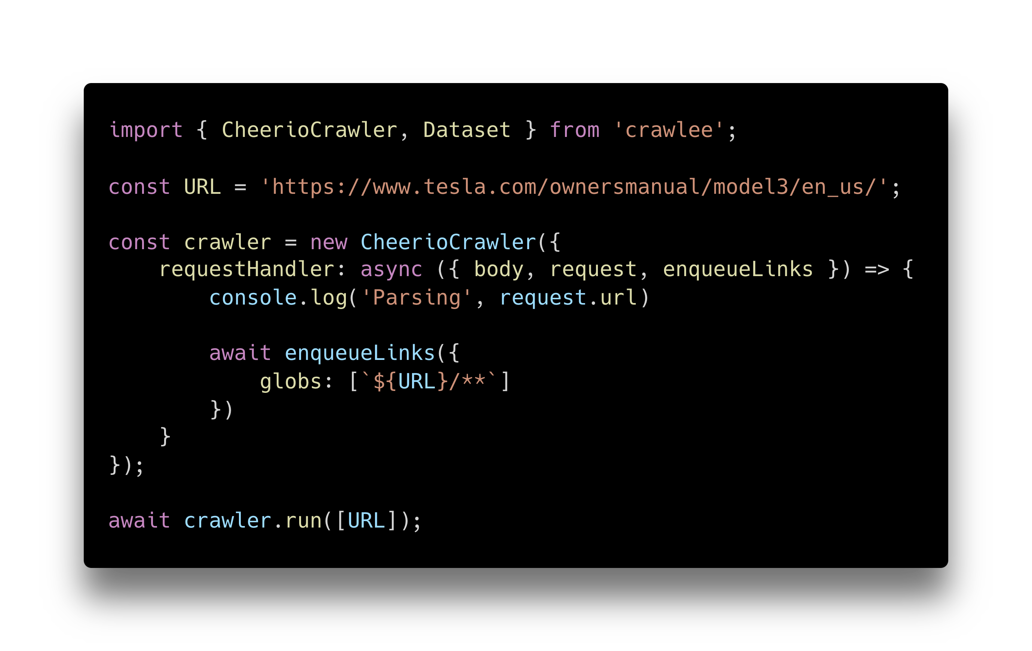
Notes:
We'll start by scraping the whole Tesla Model 3 owner's manual. We'll use Crawlee for that, and we'll use the CheerioCrawler from there. To CheerioCrawler, we'll pass a function that will be run on each scraped webpage. This function gets the scraped webpage, parsed through Cheerio, which is a library for working with HTML in Node.js, and it finds all the links which match the URL we want to scrape, and enqueues them for further scraping.

Slide 64
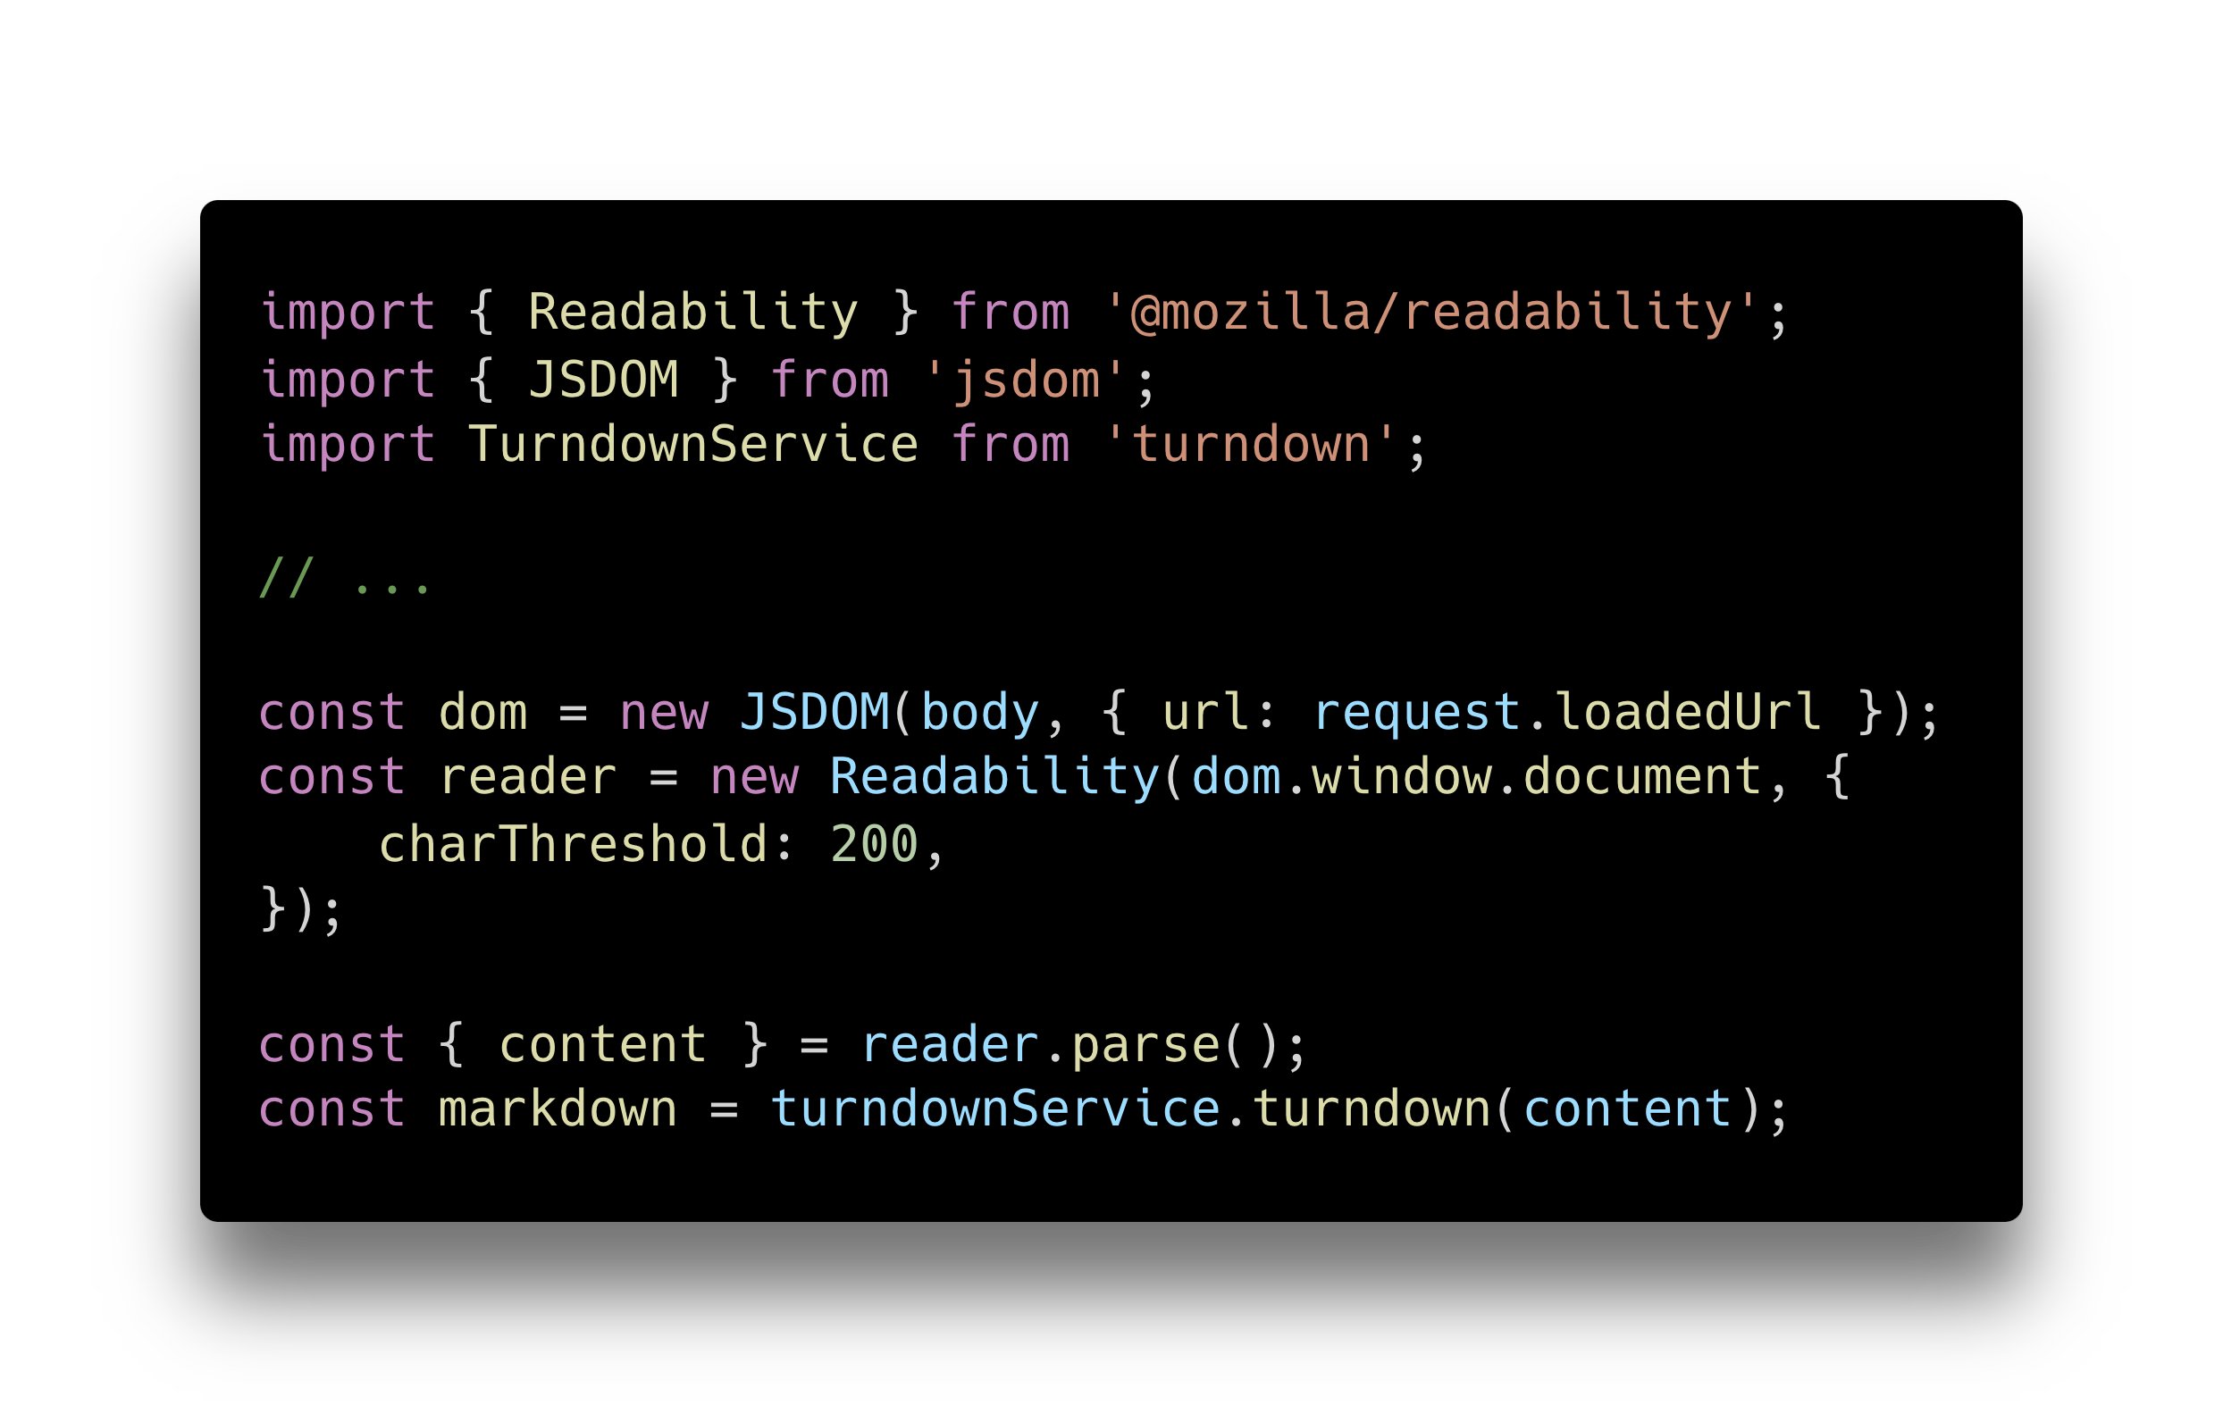
Notes:
So now that we're scraping all the webpages, we'll have to parse their content. First, we'll feed the webpage to the Readability library, to get the simplified view of the webpage. Readability doesn't work directly on HTML, but on the Document Object Model, so we'll create one with JSDOM. And then we'll take that simplified HTML, and turn it into Markdown, to save on size.

Slide 65
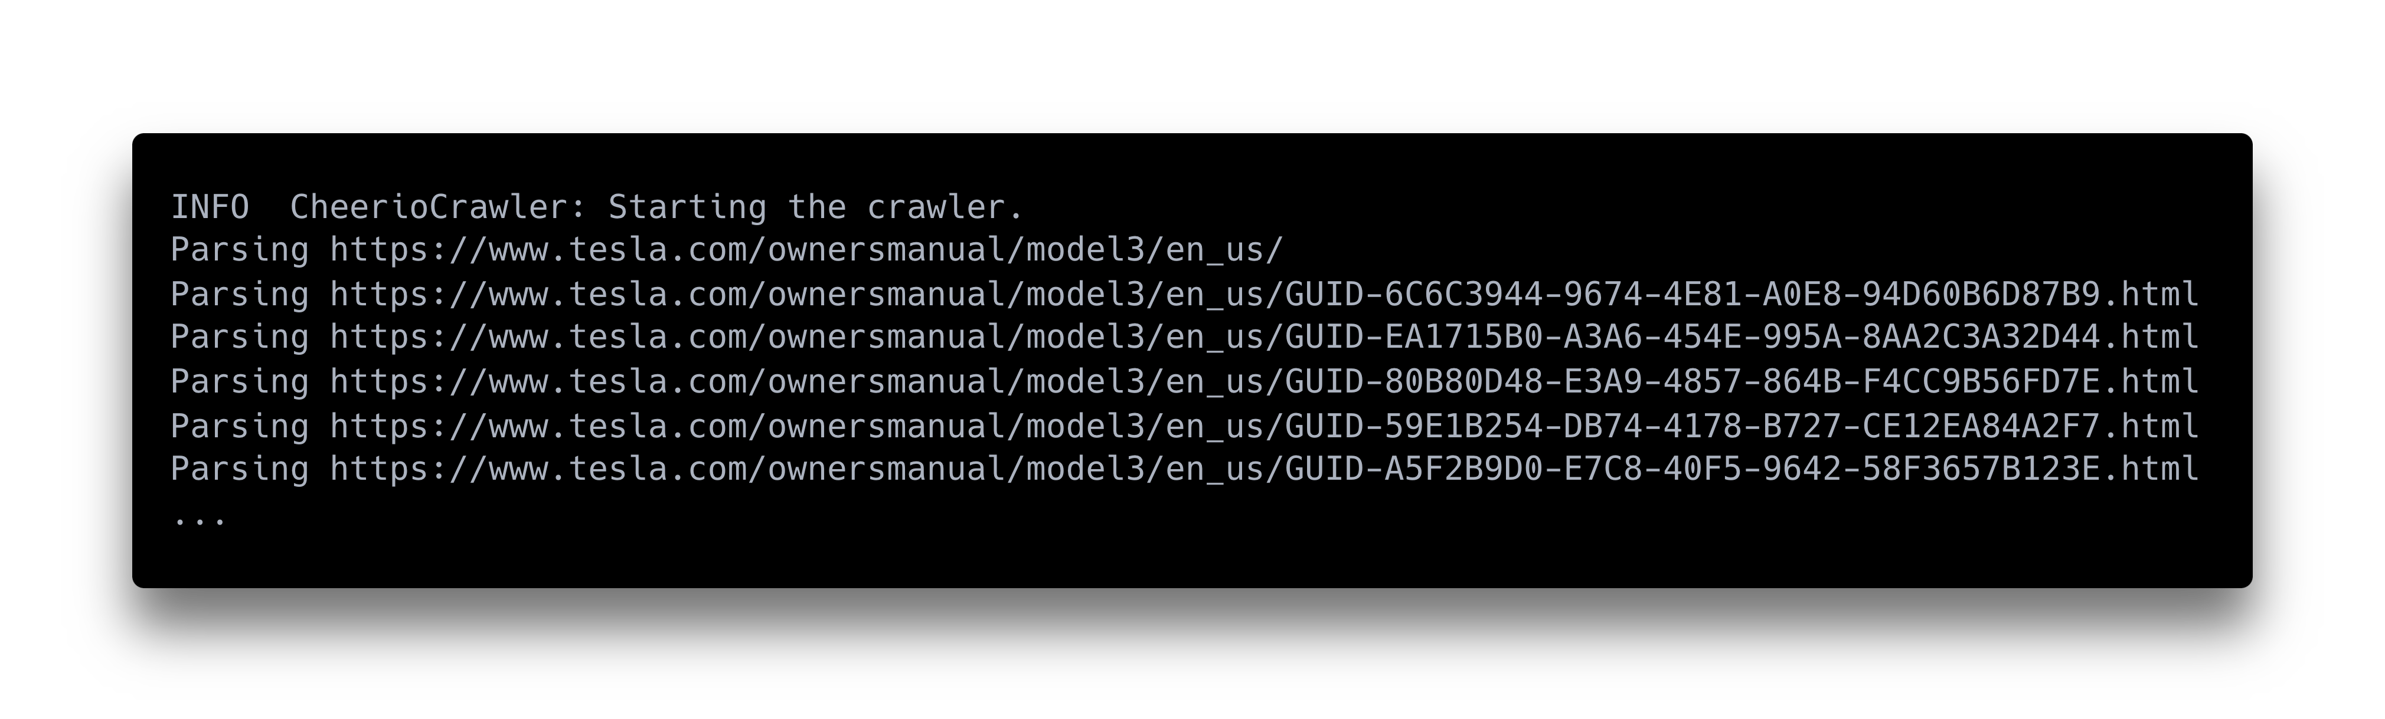
Notes:
So if we run it, we can see it first scrapes the main URL we supplied to it, and then all the child URLs that are linked from there.

Slide 66
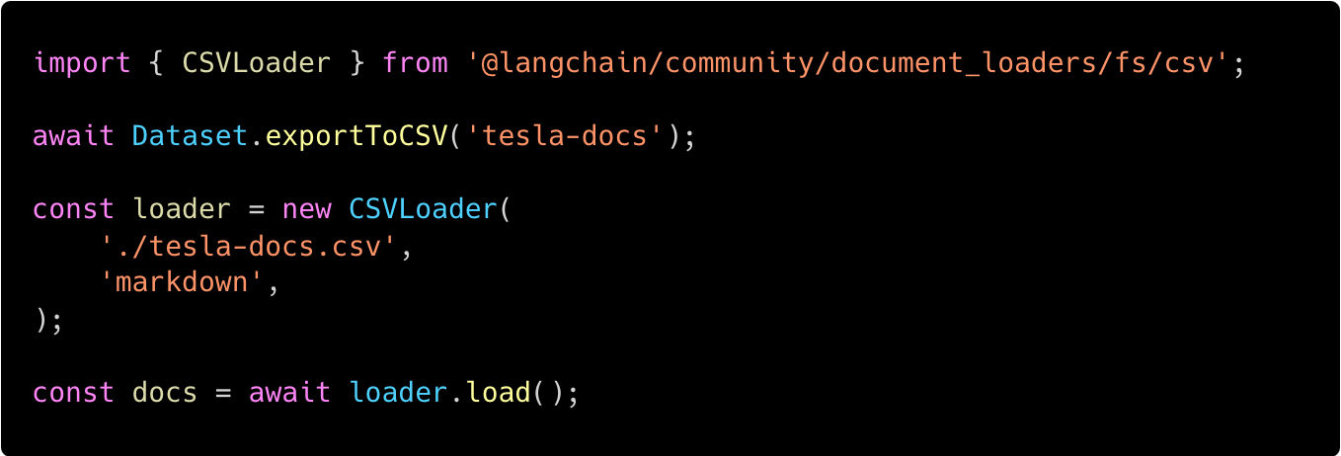
Notes:
We'll export the scraped dataset into a CSV, and load that CSV into langchain. It's funny how all the building blocks are fitting together.

Slide 67
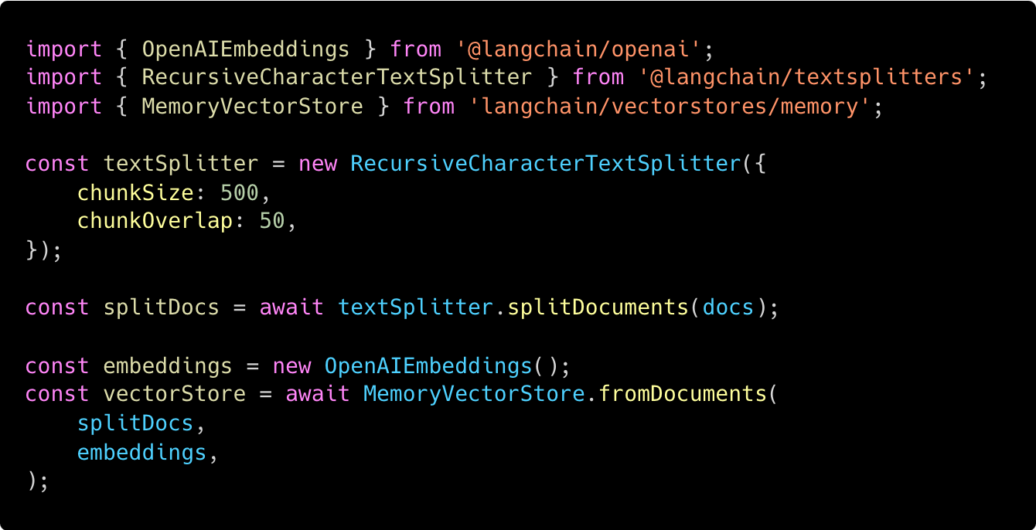
Notes:
We'll then need to put the documents into a vector database, so that the LLM can query them easily. We'll need to split them into reasonably sized chunks, with some overlap, for which LangChain has some built-in methods. Then we'll create embeddings from those chunks. We'll be using OpenAI in the chatbot, so we'll create embeddings for OpenAI. And finally, we'll store the embeddings into a vector store. We'll use just an in-memory vector store, as for this simple usecase it's enough. In a real-world application, you'd separate the scraping part and the chatbot part, so you don't have to recreate the embeddings for every question, so you'd use some persistent vector store.

Slide 68
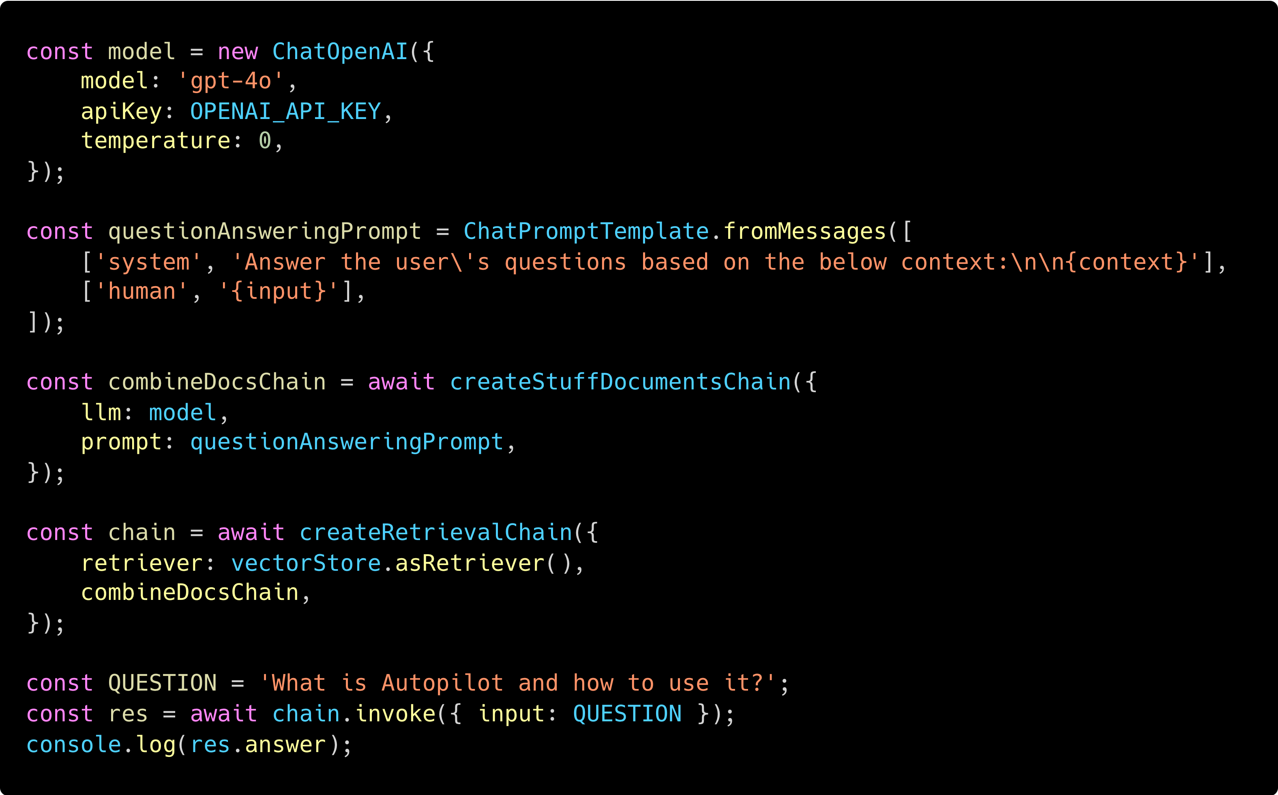
Notes:
And, finally, we'll ask the actual question. We'll create a chatting model for OpenAI, which will take the question, find the right document to answer the question from the vector store, and then create an answer for the question based on the proper document. So, if we ask the chatbot "What is Autopilot and how to use it?",

Slide 69
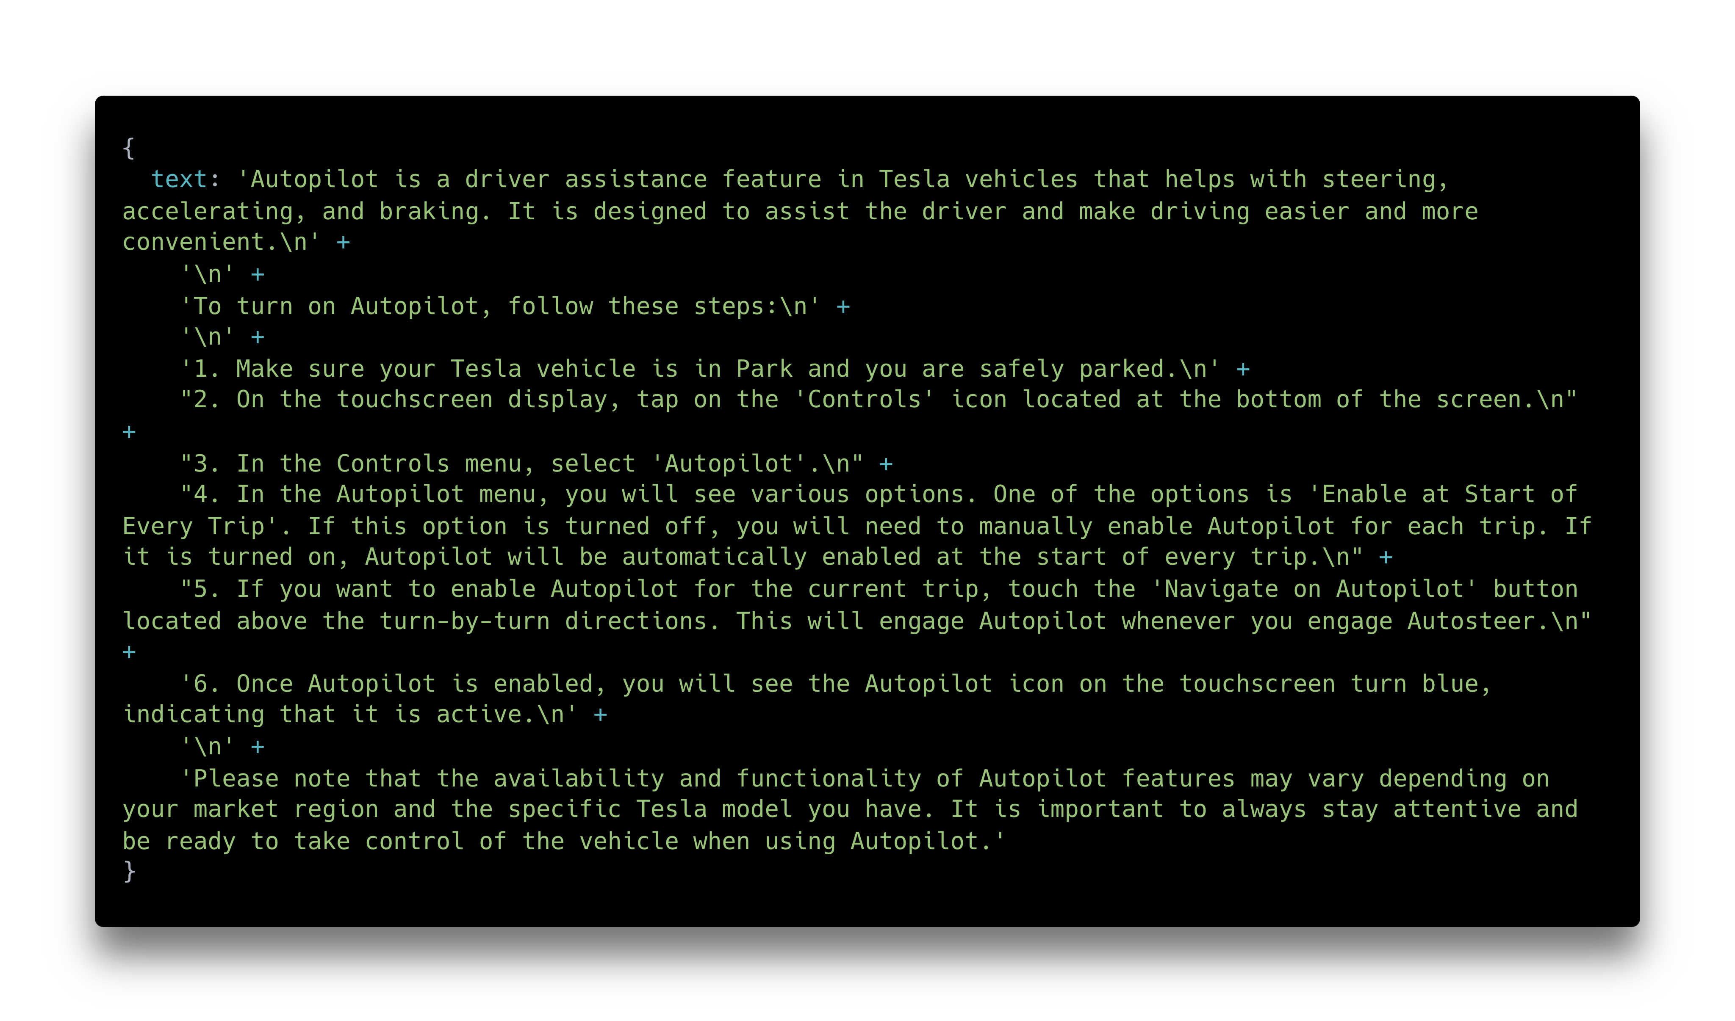
Notes:
It will give us the right answer. "Autopilot is a driver assistance feature in Tesla vehicles that helps with steering…" and so on and so on. This looks about right.

Slide 70
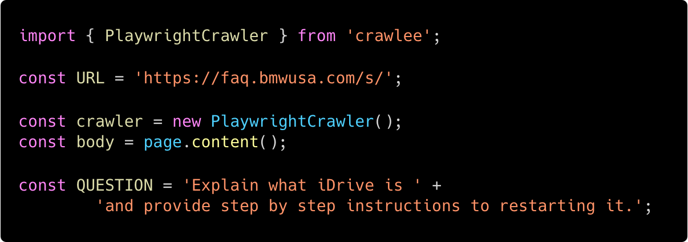
Notes:
Let's try adjusting the chatbot for the BMW website. We just need to change the URL, change the question, and switch the crawling to use PlaywrightCrawler instead of CheerioCrawler, because the BMW website is lazy-loaded and needs to be scraped using a browser, and in this case we'll do that through PlayWright.

Slide 71
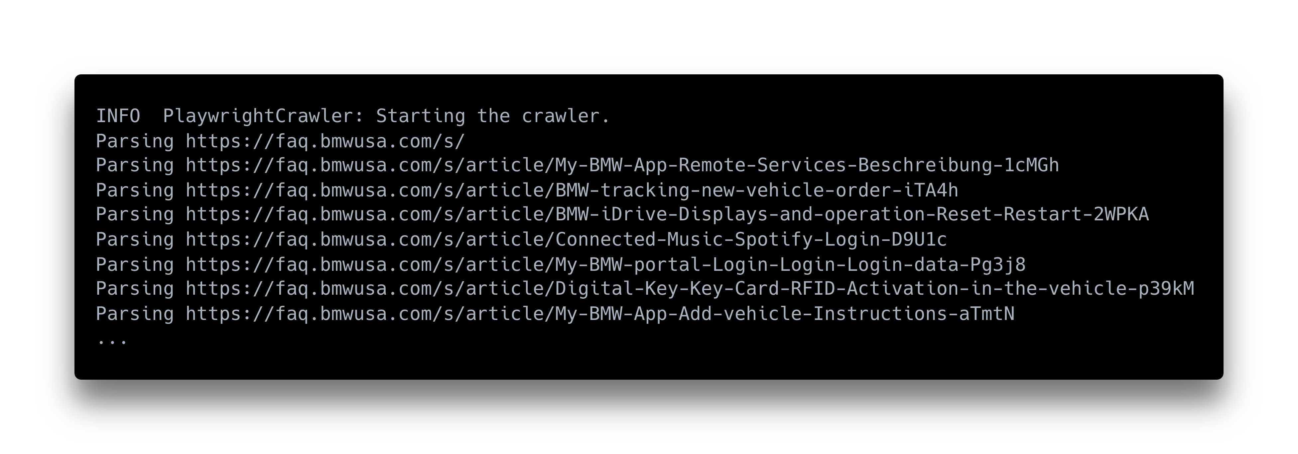
Notes:
We start it, it scrapes the articles on the BMW help website,

Slide 72
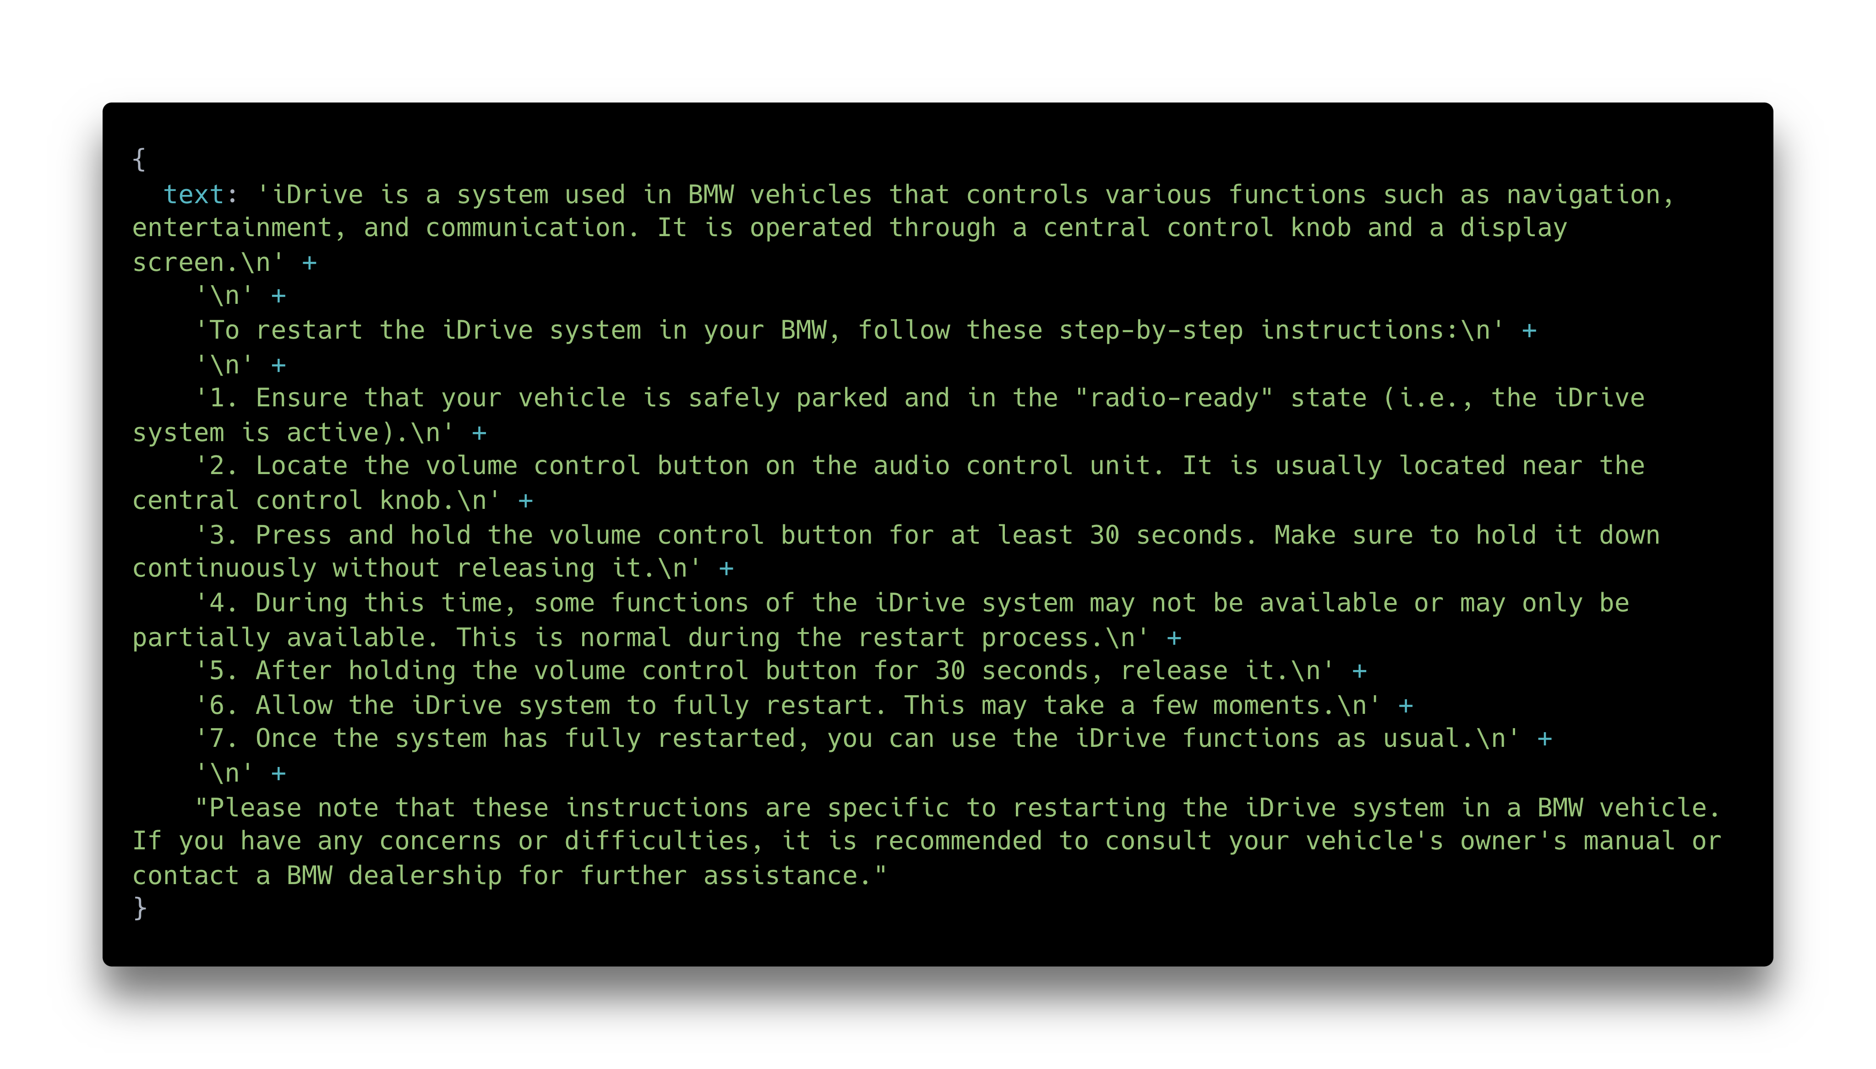
Notes:
And it gives us an answer. "iDrive is a system used in BMW vehicles that controls various functions such as navigation, entertainment," and so on and so on. That also looks about right.

Slide 73
Notes:
And that's it! Now, if you don't want to deal with all this complexity yourself, as I've said, we've made the Website Content Crawler, which deals with all the hard aspects of web scraping for you. You just give it an URL of a website, and it automatically detects all the right settings, whether you need to use a browser or not, and just gives you the content of the website including all the subpages.

Slide 74
Thank you.
Notes:
And now that's really it. Thanks so much for your attention, it's been a great privilege talking to you here.

Slide 75

github.com/apify/devworld2025
Notes:
If you want to take a look at the code that was used in this presentation, we've published it on GitHub under this URL, so you can run those examples yourself and see that they work. Thank you! TODO: push the repo TODO: maybe QR

Slide 76
